Slide 1
Connecting with Millennials and Gen Z
PART 2
Steve Case
Stewardship Workshop
NAD Ministries Convention
January 9, 2023

Slide 2
Connecting with Millennials and Gen Z
PART 1
A Quick Review of:

Slide 3



Generations as
FAMILY
Generations as
an AGE RANGE

Slide 4
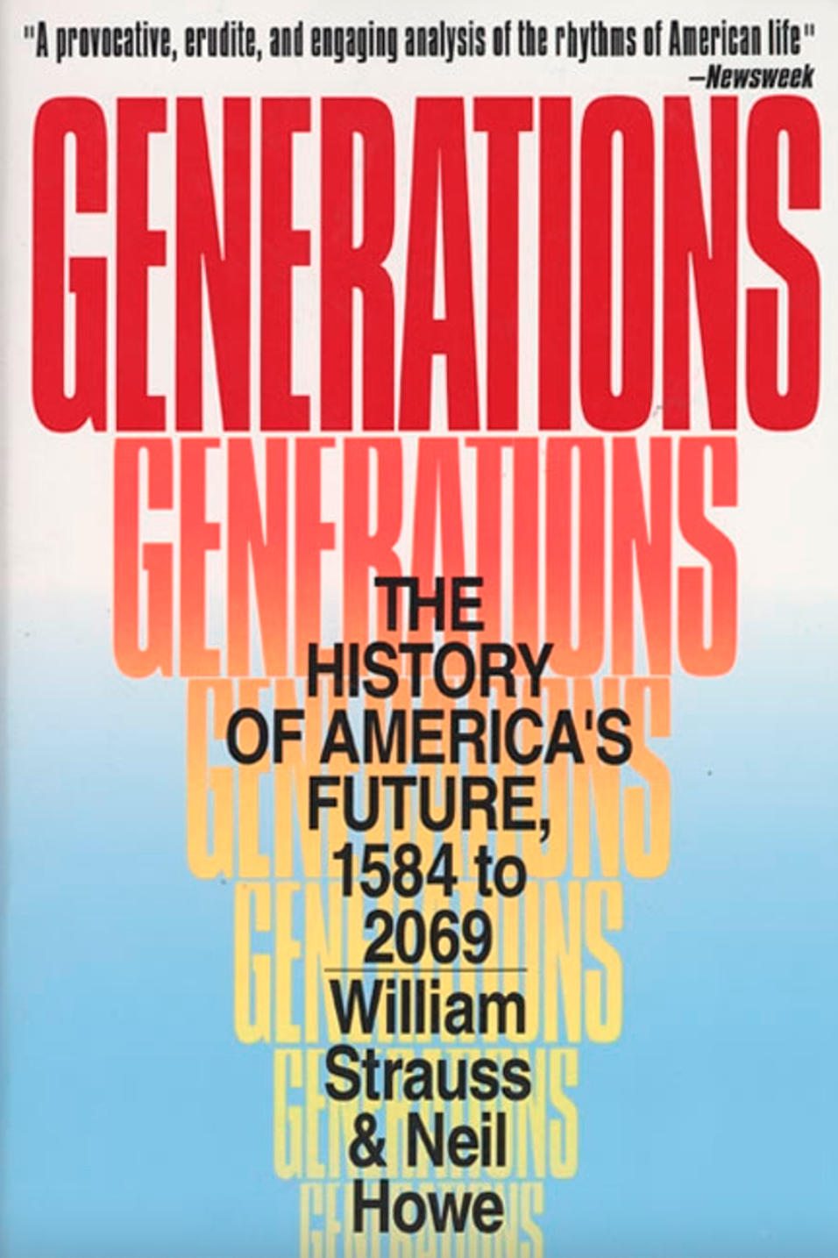
Strauss & Howe 1991
4-stage cycle of generations;
20-25 years for each generation

Slide 5
Baby Boomers
Gen X (Baby Busters)
Millennials (Gen Y)
Gen Z
Birth Years
Generational Name
Ages Now
1946-1964
1965-1980
1981-1996
1997-2012
58-74
42-57
26-41
10-25

Slide 6
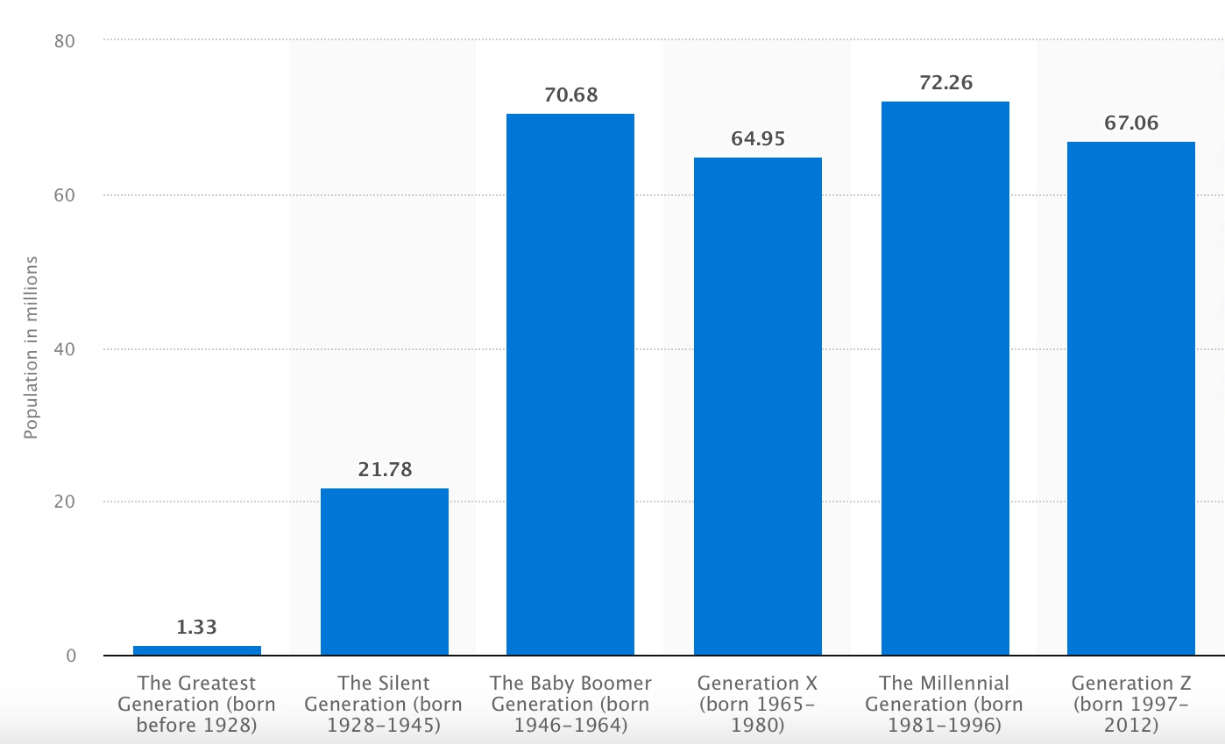
Numbers Matter!
2020
U.S. Census
GI
Sil.
BB
X
Mil.
Z

Slide 7
Critique of Generational Theory
Cherry-picking examples
Primarily for niche marketing
U.S.–centric, white
What makes a “generation”?

Slide 8
The Next Generation
The problem is:
1. They aren’t exactly like us
2. They’re at a different stage of
life compared to us

Slide 9

Not Just a Matter of Generations
    1. Period Effects (terrorism)
    2. Life-Cycle Effects (puberty)
3. Cohort Effects (digital natives)
2021

Slide 10
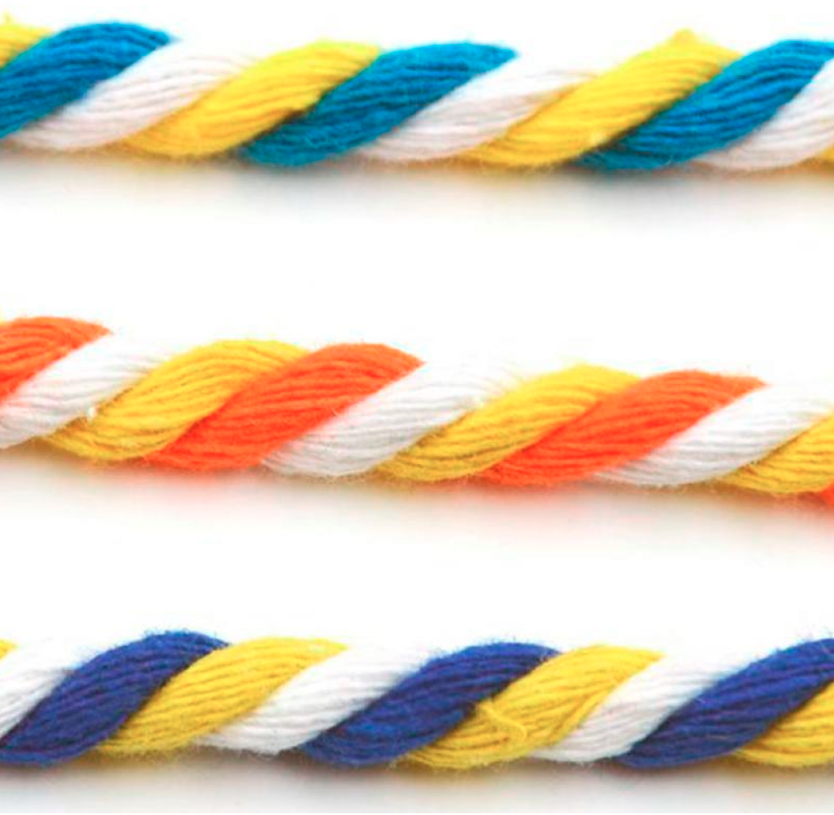
How to View “Millennials”
1. Generational Cohort
2. Stage of Development
3. Event & Culture Change

Slide 11
“Connecting with Millennials and Gen Z”

Slide 12
End of the Review of Part 1
“Connecting with Millennials and Gen Z”

Slide 13
End of the Review of Part 1
“Connecting with Millennials and Gen Z”
Start of Part 2

Slide 14
Our 2 Desires
We want Millennials and Gen Z to engage in:
1. Church
2. Stewardship

Slide 15
7 Tips for
SDA Stewardship for Millennials and Gen Z

Slide 16
7 Tips for SDA Stewardship for Millennials and Gen Z
1. A cause I believe in

Slide 17
7 Tips for SDA Stewardship for Millennials and Gen Z
1. A cause I believe in
2. Some $

Slide 18
7 Tips for SDA Stewardship for Millennials and Gen Z
1. A cause I believe in
2. Some $
3. My voice
(input)

Slide 19
7 Tips for SDA Stewardship for Millennials and Gen Z
1. A cause I believe in
2. Some $
3. My voice
(input)
4. Collaborative

Slide 20
7 Tips for SDA Stewardship for Millennials and Gen Z
1. A cause I believe in
5. Personal
counts
more than institutional
2. Some $
3. My voice
(input)
4. Collaborative

Slide 21
7 Tips for SDA Stewardship for Millennials and Gen Z
1. A cause I believe in
6. Space for the Holy Spirit
5. Personal
counts
more than institutional
2. Some $
3. My voice
(input)
4. Collaborative

Slide 22
7 Tips for SDA Stewardship for Millennials and Gen Z
1. A cause I believe in
6. Space for the Holy Spirit
5. Personal
counts
more than institutional
2. Some $
7. Sporadic rather than systematic
3. My voice
(input)
4. Collaborative

Slide 23
Lake Union
Youth Evangelism Conference

Slide 24
Young Adult Gathering
Matching Money for Grants
Conference & Union Leadership
Local Church pastor & board
Evangelism ideas from young adults

Slide 25
Young Adult Gathering
Matching Money for Grants
Conference & Union Leadership
Local Church pastor & board
Evangelism ideas from young adults
Website: lucyouth.org

Slide 26
YouTube link for testimony about the Lake Union Conference
Young Adult Evangelism Conference
https://www.youtube.com/watch?v=Zag0iyG4zOQ&t=5s

Slide 27
2 More Tips for
SDA Stewardship for Millennials and Gen Z

Slide 28
2 Tips for SDA Stewardship for Millennials and Gen Z
You don’t believe
“Once saved, always saved”
So don’t practice it

Slide 29
2 Tips for SDA Stewardship for Millennials and Gen Z
You don’t believe
“Once saved, always saved”
So don’t practice it
TRANSITIONS
“Natural times”
to leave
or to join

Slide 30
How to Connect with Millennials and Gen Z

Slide 31
How to Connect with Millennials and Gen Z
Hint: They are not at church

Slide 32
How to Connect with Millennials and Gen Z
Hint: They are not at church
Hint: We need to go to them

Slide 33

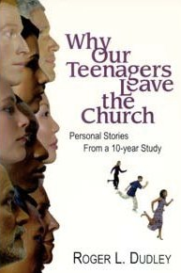
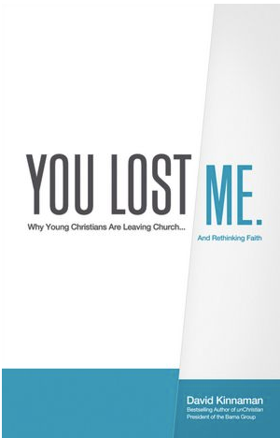

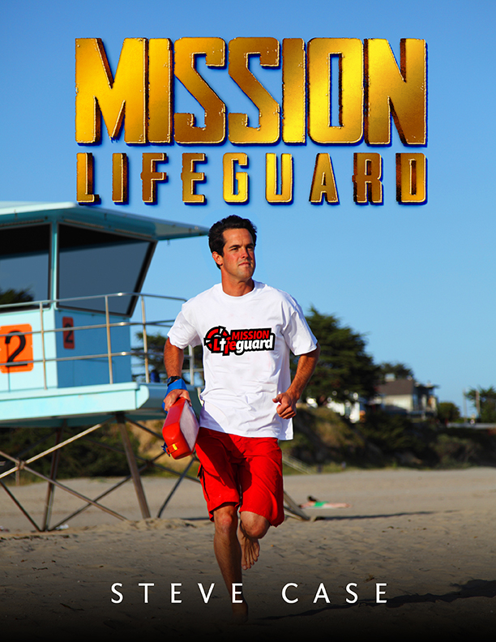
Young People Leaving the Church
1978
2000
2011
2012
2014

Slide 34
Adult Church Attendance in the U.S. from 1974-2018

Slide 35
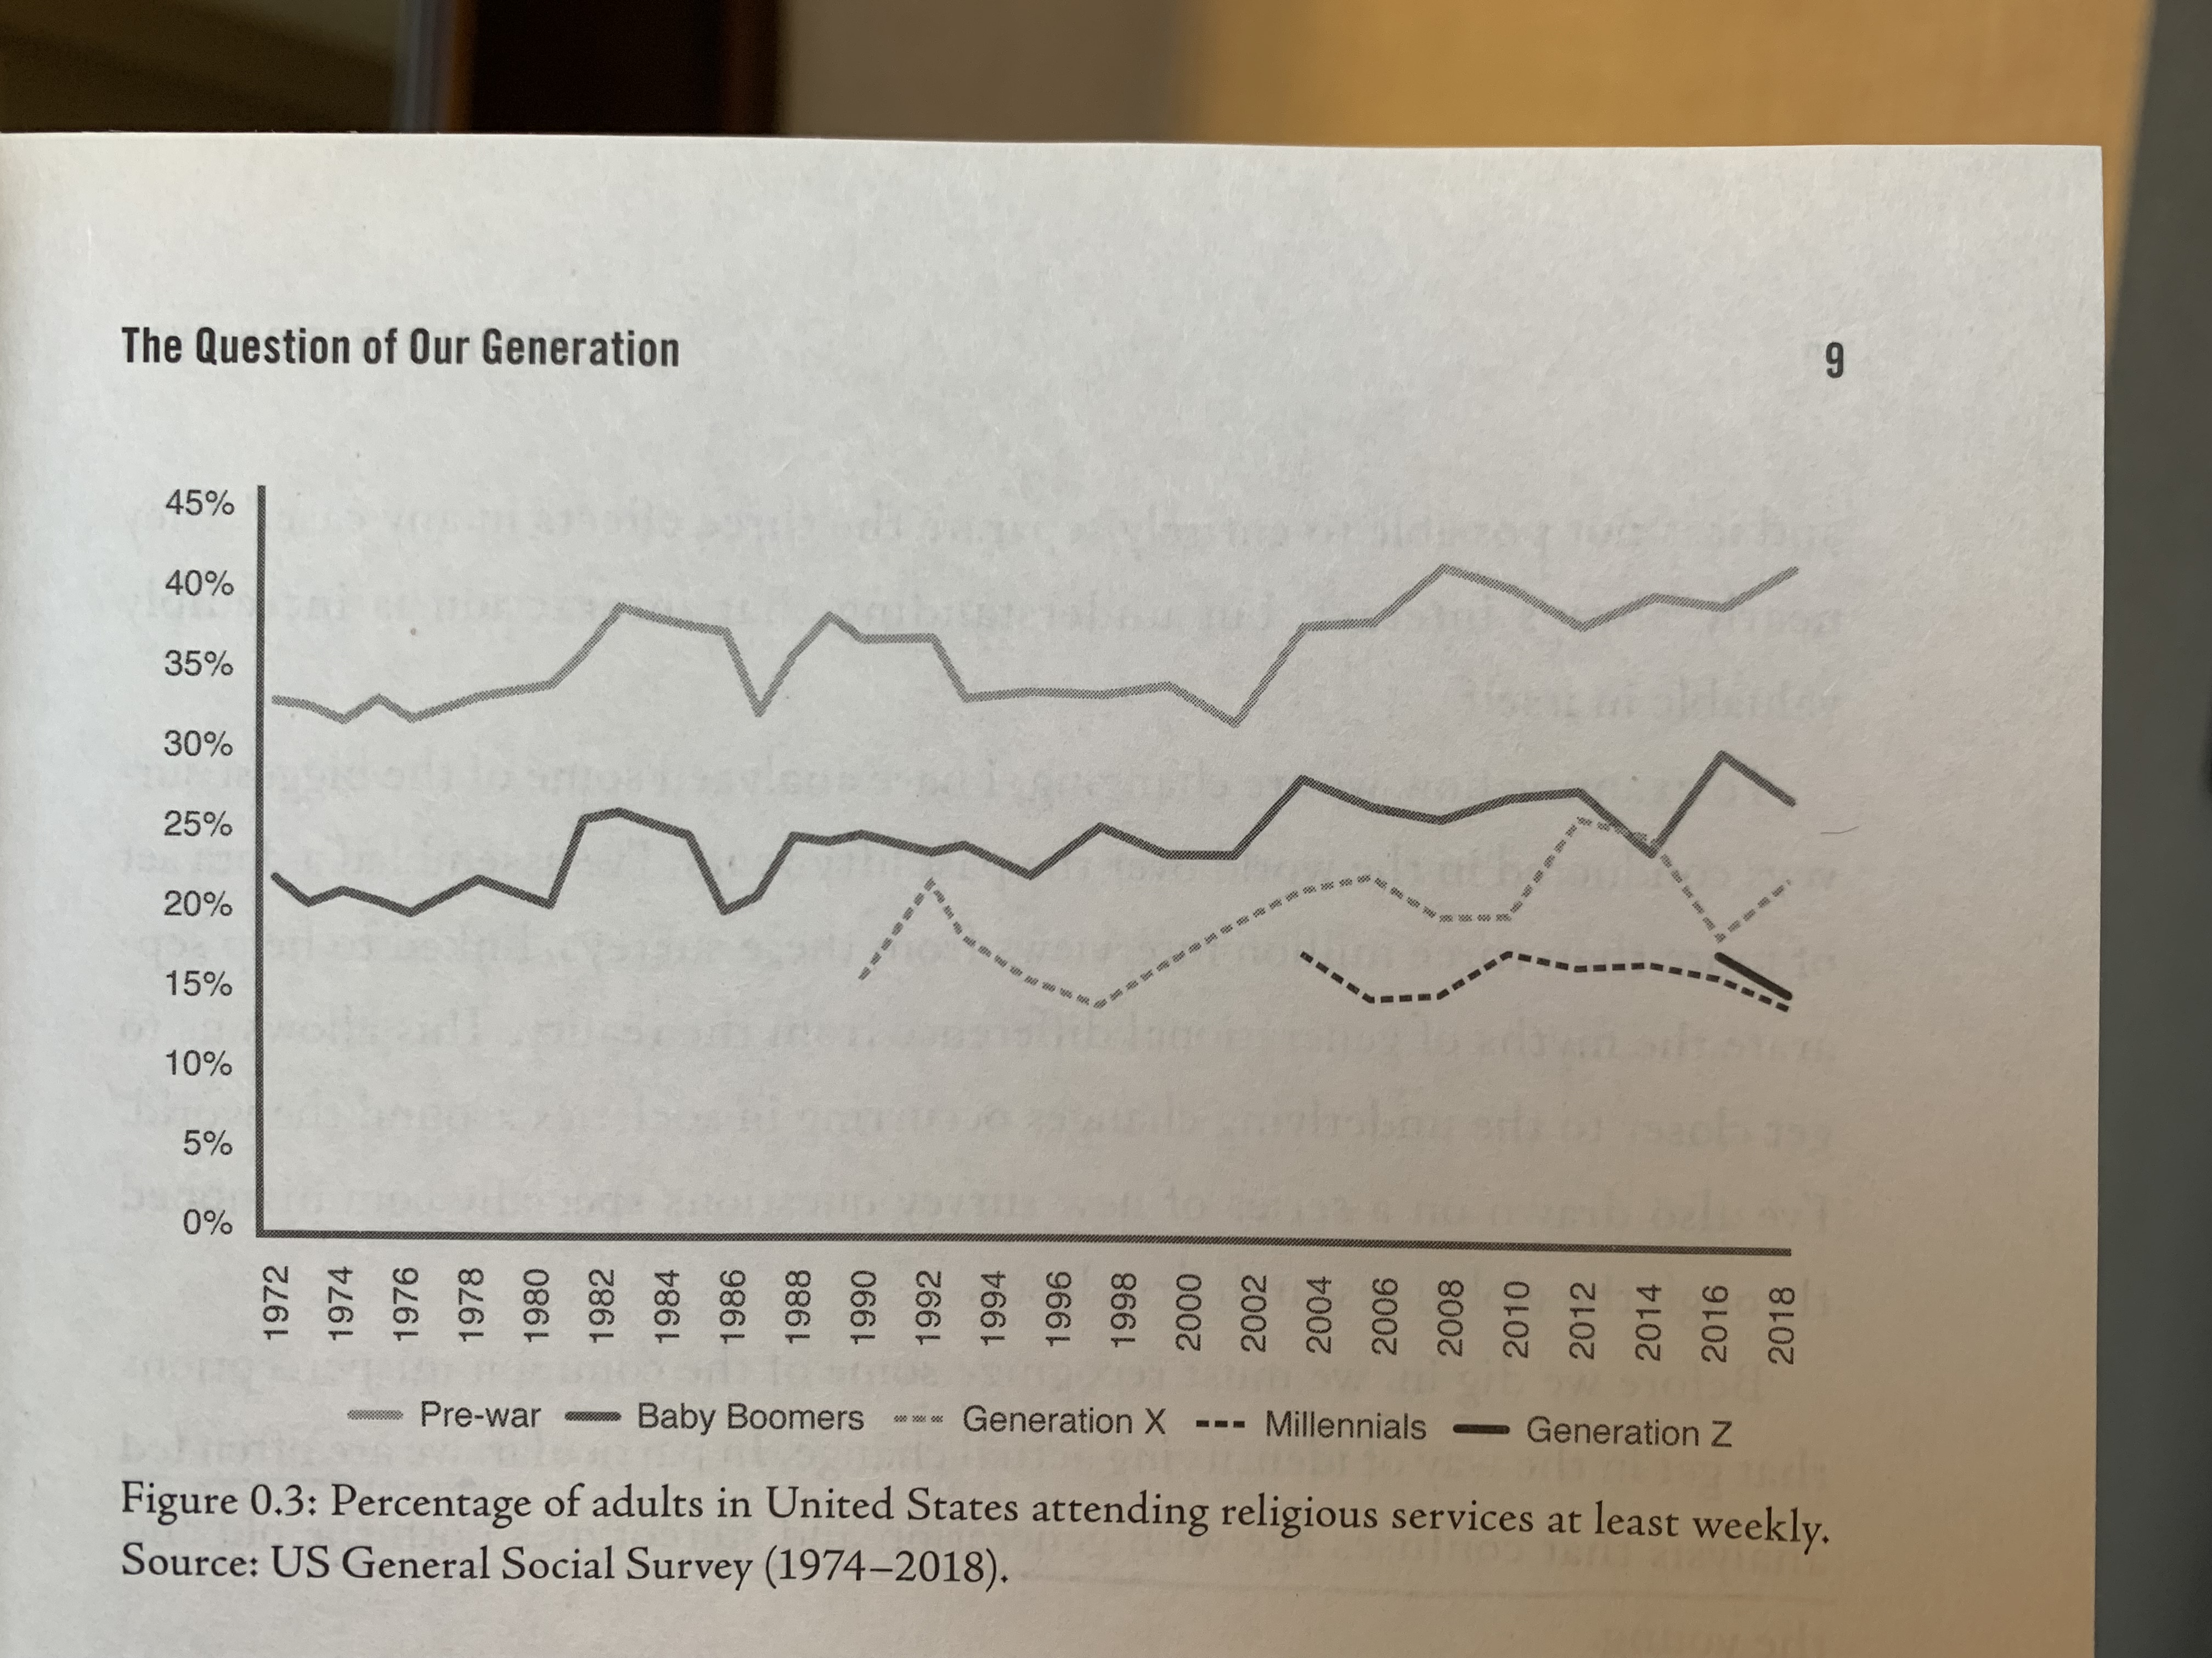
Percentage of adults in the US attending church each week (1974-2018)
Silent Generation

Slide 36
Percentage of adults in the US attending church each week (1974-2018)
Baby Boomers

Slide 37
Percentage of adults in the US attending church each week (1974-2018)
Gen X

Slide 38
Percentage of adults in the US attending church each week (1974-2018)
Millennials

Slide 39
Percentage of adults in the US attending church each week (1974-2018)
Gen Z

Slide 40
The “Religion” of America

Slide 41
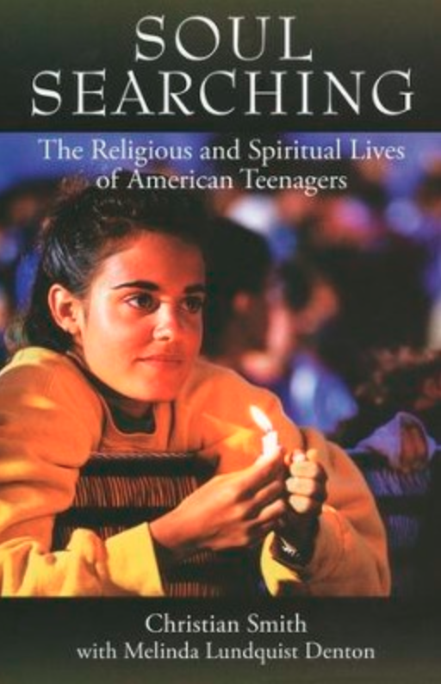
Moralistic
Therapeutic
Deism
Christian Smith
NSYR
2005

Slide 42
1. God does exist. He created the world and watches over human life.

Slide 43
1. God does exist. He created the world and watches over human life.
2. God wants people to be good, nice, and fair.

Slide 44
1. God does exist. He created the world and watches over human life.
2. God wants people to be good, nice, and fair.
3. The main goal of life is to be happy and feel good about oneself.

Slide 45
4. God doesn’t need to be involved in one’s life unless you need him to solve a problem or something.

Slide 46
4. God doesn’t need to be involved in one’s life unless you need him to solve a problem or something.
5. Good people go to heaven when they die.

Slide 47
This is the dominant “religion” of most Millennials and Gen Z in the U.S. now.

Slide 48
This is the dominant “religion” of most Millennials and Gen Z in the U.S. now.
Where did they come up with this?

Slide 49
This is the dominant “religion” of most Millennials and Gen Z in the U.S. now.
Where did they come up with this?
Their parents have these same beliefs.

Slide 50
This is the dominant “religion” of most Millennials and Gen Z in the U.S. now.
Where did they come up with this?
Their parents have these same beliefs.
Source of authority: It’s in you; figure it out.

Slide 51
Those in the NAD now live in a
Post-Christian world

Slide 52
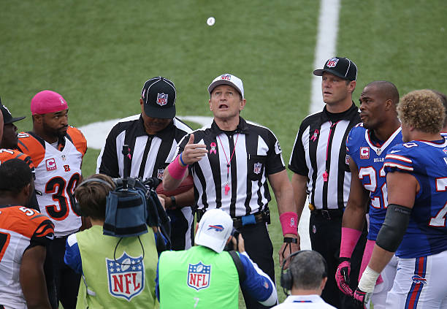
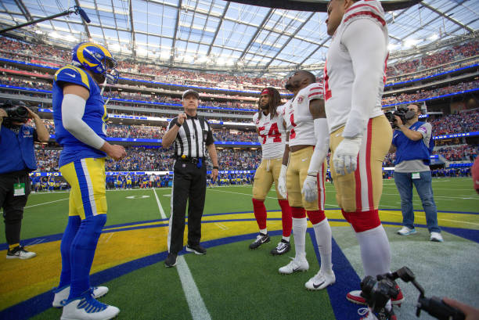
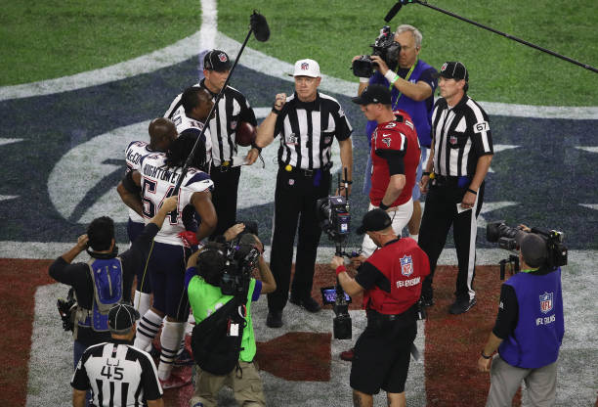
Covered on TV

Slide 53
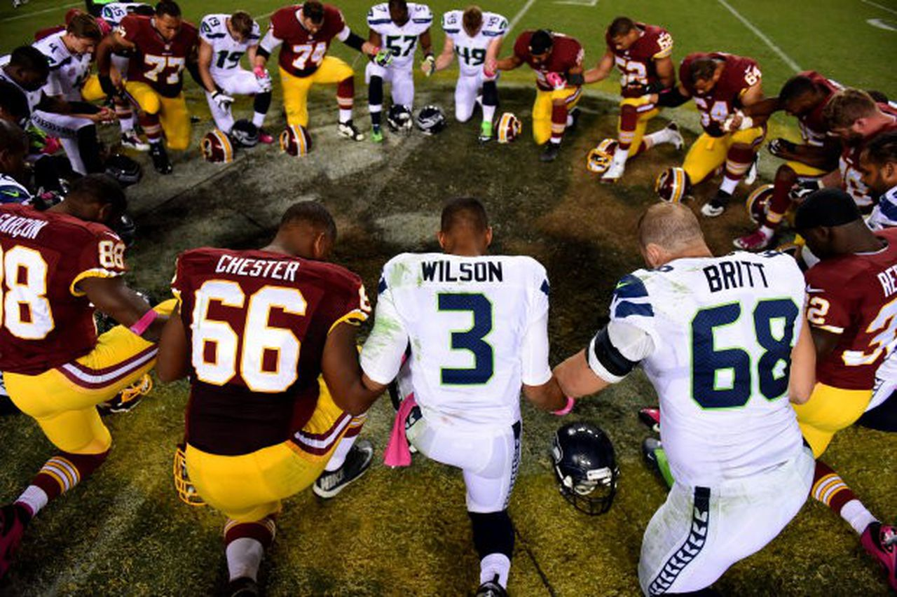
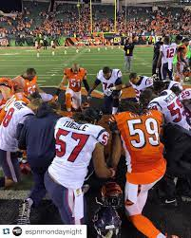
NOT covered on TV

Slide 54
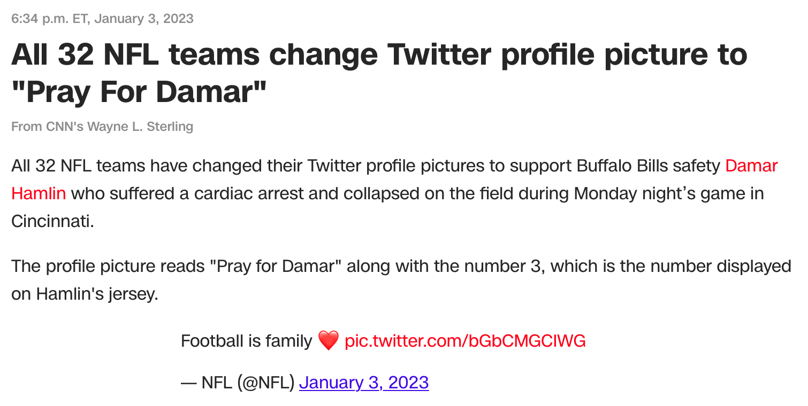
Is this typical or exceptional?
How long will it be news?

Slide 55

Set in England
100 years ago

Slide 56
In a Post-Christian world, Christianity exists,
but keep it to yourself;
private, not in the public square.

Slide 57
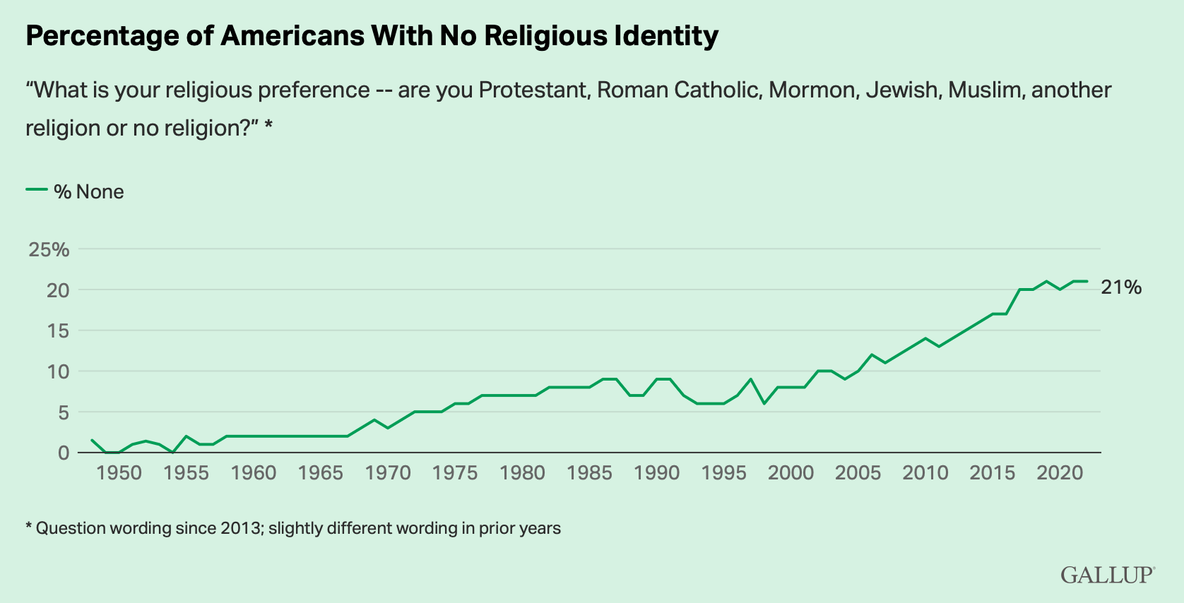
“Nones”
The fastest growing religious group

Slide 58
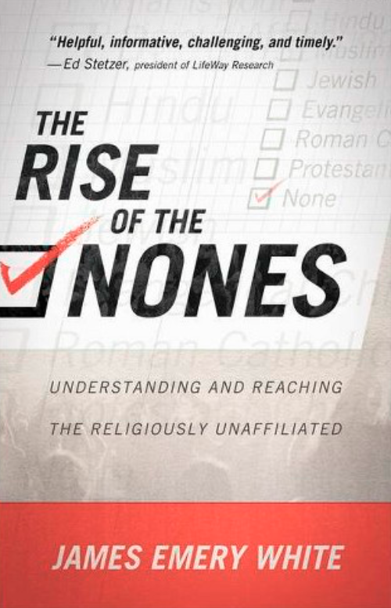

James Emery White
2014
2017

Slide 59
Where are people on this line?
Choose God
Secular
1
2
3
4
5
6
7
8
9
10

Slide 60


Where people are in a Christian culture
Choose God
Secular
1
2
3
4
5
6
7
8
9
10

Slide 61
Where people are in a Christian culture
Choose God
Secular
1
2
3
4
5
6
7
8
9
10
Move 1-2 spots to the right for baptism

Slide 62
Where people are in a secular culture
Choose God
Secular
1
2
3
4
5
6
7
8
9
10

Slide 63
Where people are in a secular culture
Choose God
Secular
1
2
3
4
5
6
7
8
9
10
Move 1-2 spots to the right is good, but not far enough for a baptism

Slide 64
The challenge of
the old who attend
versus
the young
who don’t attend

Slide 65
OPTION 1
Make church appeal to
the old who attend
(alienate
the young)

Slide 66
OPTION 1
OPTION 2
Make church appeal to
the old who attend
(alienate
the young)
Make church appeal to
the young
who don’t attend
(alienate
the old)

Slide 67
OPTION 1
OPTION 2
4
G
R
O
U
P
S
Make church appeal to
the old who attend
(alienate
the young)
Make church appeal to
the young
who don’t attend
(alienate
the old)

Slide 68
4
G
R
O
U
P
S
1. Boomer
2. Gen X
3. Millennial
4. Gen Z

Slide 69
OPTION 1
OPTION 2
4
G
R
O
U
P
S
Make church appeal to
the old who attend
(alienate
the young)
Make church appeal to
the young
who don’t attend
(alienate
the old)

Slide 70
OPTION 1
OPTION 2
Make church appeal to
the old who attend
(alienate
the young)
Make church appeal to
the young
who don’t attend
(alienate
the old)
Is there a 3rd way?

Slide 71
4
G
R
O
U
P
S
1. Your group is the only one.
2. Each group meets on its own.
3. Send one person to instruct another group.
4. Form groups that interact with each other.

Slide 72
4
G
R
O
U
P
S
1. Your group is the only one.
2. Each group meets on its own.
3. Send one person to instruct another group.
4. Form groups that interact with each other.

Slide 73
4
G
R
O
U
P
S
1. Your group is the only one.
2. Each group meets on its own.
3. Send one person to instruct another group, but no feedback.
4. Form groups that interact with each other.

Slide 74
4
G
R
O
U
P
S
1. Your group is the only one.
2. Each group meets on its own.
3. Send one person to instruct another group, but no feedback.
4. Form groups that interact with each other.

Slide 75
1. Mono-Generational
Multi-Generational
Cross-Generational
Inter-Generational

Slide 76
1. Mono-Generational
2. Multi-Generational
Cross-Generational
Inter-Generational

Slide 77
1. Mono-Generational
2. Multi-Generational
3. Cross-Generational
Inter-Generational

Slide 78
1. Mono-Generational
2. Multi-Generational
3. Cross-Generational
4. Inter-Generational

Slide 79
“Growing Together”
Small, medium, or large church
Urban, suburban, or rural
Old, young, or middle-age
Rich, poor, or middle-class
North, South, East, West, Midwest
USA or outside the USA

Slide 80
“Growing Together” Commitments
1. Unlock keychain leadership.
2. Empathize with today’s young people.
3. Take Jesus’ message seriously.
4. Fuel a warm community.
5. Prioritize young people and families in everything you do.
6. Be the best neighbors.

Slide 81
Instead of an
“ATTRACTIONAL MODEL”
that leads to Consumer Christianity

Slide 82
Instead of an
“ATTRACTIONAL MODEL”
that leads to Consumer Christianity
Go with the Gospel Commission
    Matthew 28:18-20

Slide 83
Jesus came to his disciples and said,
”All authority in heaven and on earth has been given to me. Therefore GO and make disciples of all nations, baptizing them in the name of the Father and of the Son and of the Holy Spirit, and teaching them to obey everything I have commanded you. And surely I am with you always, to the very end of the age.”
    Matthew 28:18-20 (NIV)

Slide 84
Steve’s 10 Commandments for Connecting with Millennials and Gen Z
1. Go to them.
2. Make it about Jesus, not the church.
3. Invite them into community.
4. Listen more than you talk.
5. Expect it to be messy.

Slide 85
Steve’s 10 Commandments for Connecting with Millennials and Gen Z
6. We need each other.
7. Make it mutual.
8. Practice forgiveness and repentance.
9. God is bigger than you.
10. God’s bigger than your understanding.

Slide 86
Stewardship people,
You know all about Matt 6:21
“Where your treasure is,
there will your heart be also.”
It’s true for God, for you,
for Millennials, and for Gen Z.

Slide 87
Connecting with Millennials and Gen Z
PART 2
Steve Case
Stewardship Workshop
NAD Ministries Convention
January 9, 2023

