Slide 1
Connecting with Millennials and Gen Z
PART 1
Steve Case
Stewardship Advisory
NAD Ministries Convention
January 8, 2023

Slide 2
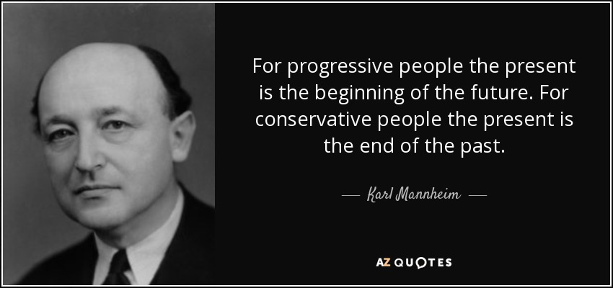
1928 German
1952 English
Generational theory rooted in
Karl Mannheim’s
The Problem of Generations

Slide 3



Generations as
FAMILY
Generations as
an AGE RANGE

Slide 4
Generations as
FAMILY
Generations as
an AGE RANGE
family,
blood line,
kinship
Age group,
coming of age,
shared together

Slide 5
For progressive people
the present is the beginning of the future.

Slide 6
For progressive people
the present is the beginning of the future.
For conservative people
the present is the end of the past.

Slide 7
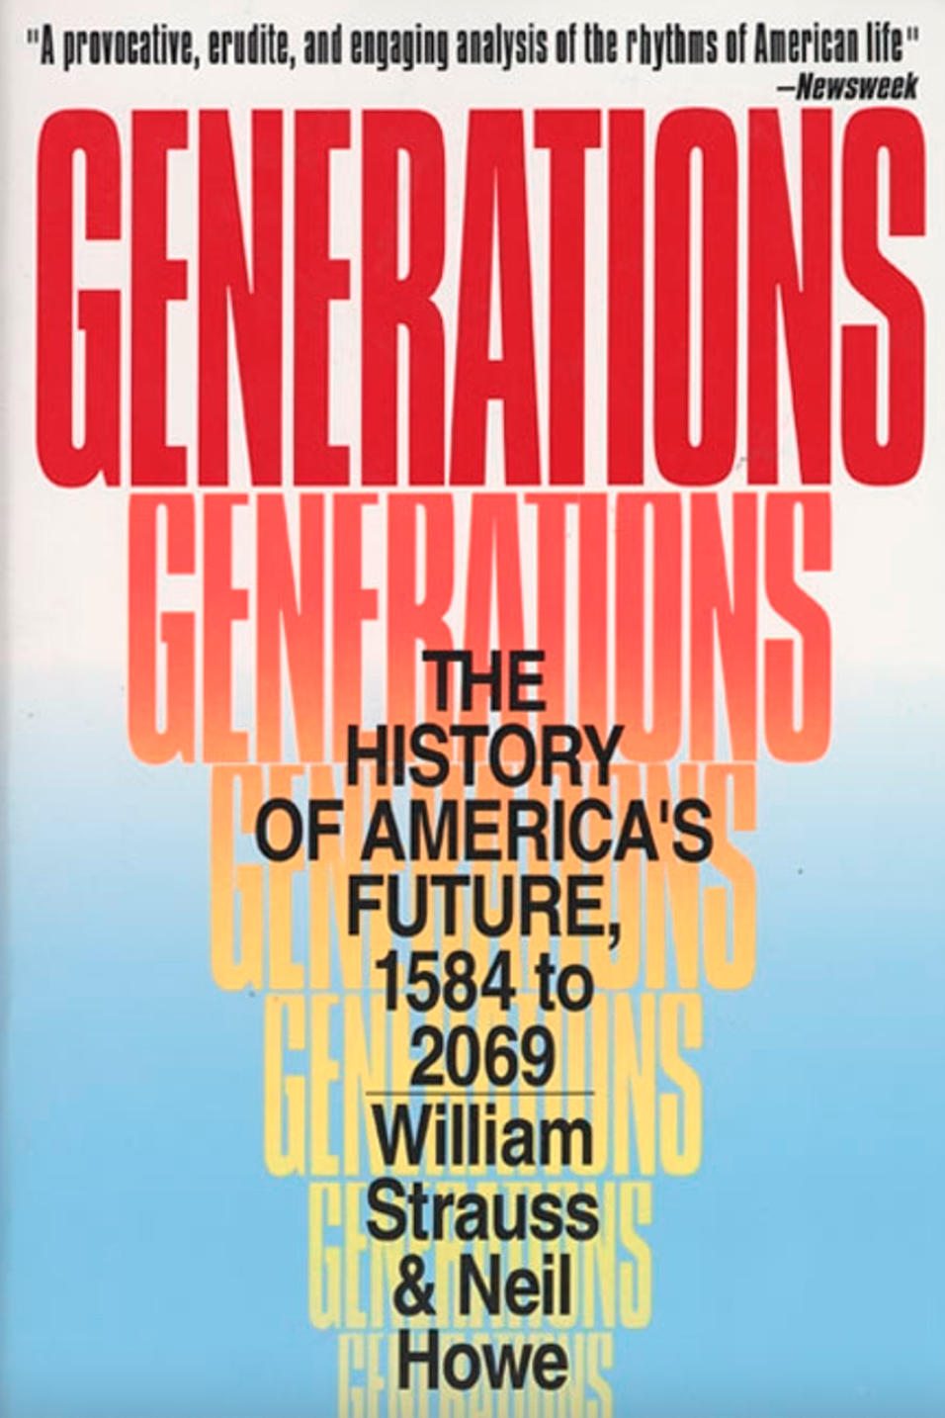
1/1/1991
Strauss & Howe

Slide 8
High/Hero–Community, Institutions
Awakening/Artist–Recapture the self
Unraveling/Prophet– Institutions, Individualism
Crisis/Nomad–Revolution, Rebuilding
4-stage cycle of archetypes
20-25 years/generation

Slide 9
High/Hero–Community, Institutions
Awakening/Artist–Recapture the self
Unraveling/Prophet– Institutions, Individualism
Crisis/Nomad–Revolution, Rebuilding
4-stage cycle of archetypes
20-25 years/cycle

Slide 10
High/Hero–Community, Institutions
Awakening/Artist–Recapture the self
Unraveling/Prophet– Institutions, Individualism
Crisis/Nomad–Revolution, Rebuilding
4-stage cycle of archetypes
20-25 years/cycle

Slide 11
High/Hero–Community, Institutions
Awakening/Artist–Recapture the self
Unraveling/Prophet– Institutions, Individualism
Crisis/Nomad–Revolution, Rebuilding
4-stage cycle of archetypes
20-25 years/cycle

Slide 12
High/Hero–Community, Institutions
Awakening/Artist–Recapture the self
Unraveling/Prophet– Institutions, Individualism
Crisis/Nomad–Revolution, Rebuilding
4-stage cycle of archetypes
20-25 years/cycle

Slide 13
High/Hero–GI Generation
Awakening/Artist–Silent Generation
Unraveling/Prophet–Baby Boomers
Crisis/Nomad–Gen X (Baby Busters)
Dates of Birth for Each Generation
1901-1927
1928-1945
1946-1964
1965-1980

Slide 14
High/Hero–GI Generation
Awakening/Artist–Silent Generation
Unraveling/Prophet–Baby Boomers
Crisis/Nomad–Gen X (Baby Busters)
Dates of Birth for Each Generation
1901-1927
1928-1945
1946-1964
1965-1980

Slide 15
High/Hero–GI Generation
Awakening/Artist–Silent Generation
Unraveling/Prophet–Baby Boomers
Crisis/Nomad–Gen X (Baby Busters)
Dates of Birth for Each Generation
1901-1927
1928-1945
1946-1964
1965-1980

Slide 16
High/Hero–GI Generation
Awakening/Artist–Silent Generation
Unraveling/Prophet–Baby Boomers
Crisis/Nomad–Gen X (Baby Busters)
Dates of Birth for Each Generation
1901-1927
1928-1945
1946-1964
1965-1980

Slide 17
High/Hero–GI Generation
Awakening/Artist–Silent Generation
Unraveling/Prophet–Baby Boomers
Crisis/Nomad–Gen X (Baby Busters)
Dates of Birth for Each Generation
1901-1927
1928-1945
1946-1964
1965-1980

Slide 18
Awakening/Artist–Silent Generation
Unraveling/Prophet–Baby Boomers
Crisis/Nomad–Gen X (Baby Busters)
Dates of Birth for Each Generation
1981-1996
High/Hero–Millennials (Gen Y)
1928-1945
1946-1964
1965-1980

Slide 19
Unraveling/Prophet–Baby Boomers
Crisis/Nomad–Gen X (Baby Busters)
Dates of Birth for Each Generation
1981-1996
High/Hero–Millennials (Gen Y)
Awakening/Artist–Gen Z
1997-2012
1946-1964
1965-1980

Slide 20
High/Hero–Millennials (Gen Y)
Awakening/Artist–Gen Z
Unraveling/Prophet–Baby Boomers
Crisis/Nomad–Gen X (Baby Busters)
Dates of Birth for Each Generation
1981-1996
1997-2012
1946-1964
1965-1980

Slide 21
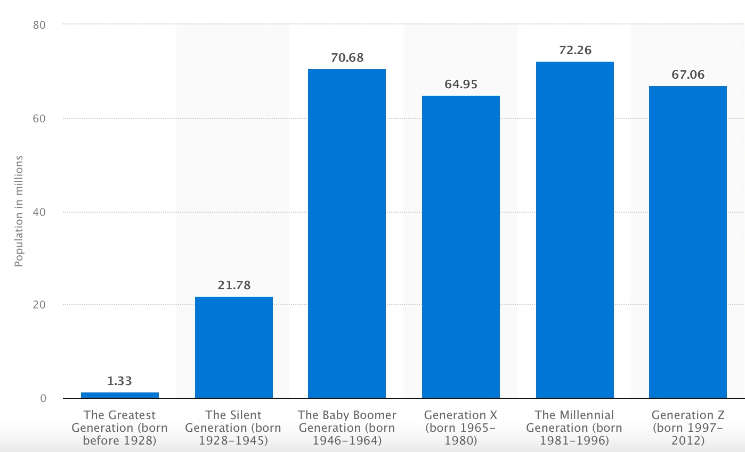
Numbers Matter!
Statista
2020 U.S.
GI
Sil.
BB
X
Mil.
Z

Slide 22
Please get up from your chair and meet me
in the middle of the room

Slide 23
1. Put one hand above your head.
2. Choose how many fingers to extend (0-5).
3. Get with 2 more people; add your fingers to equal an EVEN number.
4. Sit together as a group of 3
anywhere in this room.

Slide 24
Groups of 3
Characteristics of Millennials

Slide 25
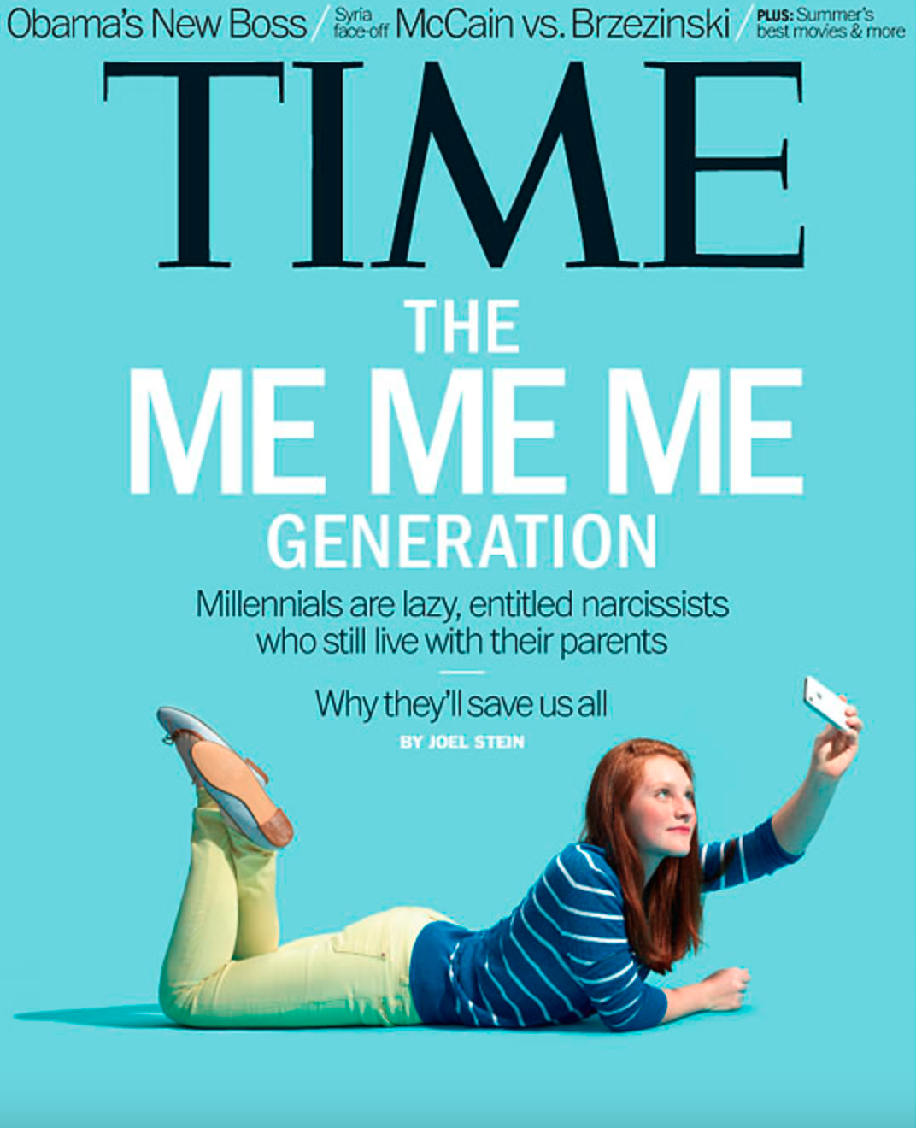
Characteristics of Millennials
May 20, 2013

Slide 26





Characteristics of Millennials

Slide 27
Characteristics of Millennials

Slide 28
A New Ministry for Millennials

Slide 29
YouTube link for “Millennial International”
https://www.youtube.com/watch?v=RGvrmltfMrA

Slide 30
A New Ministry for Millennials
What is your response?

Slide 31
Critique of Generational Theory
Cherry-picking examples
Primarily for niche marketing
U.S.–centric, white
What makes a “generation”?

Slide 32
The Next Generation

Slide 33
The Next Generation
Don’t let anyone look down on you because you are young, but set an example for the believers in speech, in conduct, in love, in faith, and in purity.
    1 Timothy 4:12 (NIV)

Slide 34
1888 Generational Dynamic

Slide 35
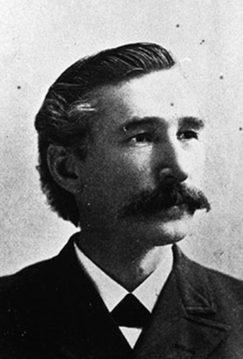
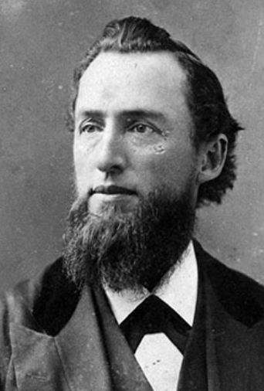
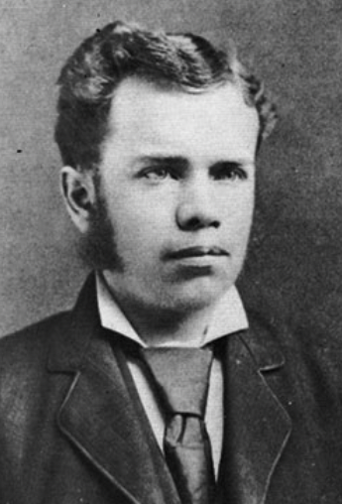
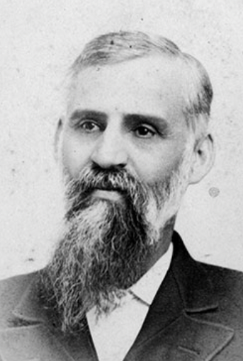
1888 Generational Dynamic
A. T.
Jones
Uriah
Smith
George
Butler
E. J.
Waggoner

Slide 36
1888 Generational Dynamic
Uriah Smith
George Butler
Conf. Presidents
Back East
50-somethings

Slide 37
1888 Generational Dynamic
A. T. Johns
E. J. Waggoner
College Professors
Out West
30-somethings
Uriah Smith
George Butler
Conf. Presidents
Back East
50-somethings

Slide 38
1888 Generational Dynamic
Galatians 3 “law”
ceremonial & moral
Signs of the Times
10 horns of Dan 7 include the Alemanni
Galatians 3 “law"
ceremonial only
Review & Herald
10 horns of Dan 7
include the Huns

Slide 39
1888 Generational Dynamic
Righteousness by Faith presented by Waggoner and Jones; endorsed by EGW

Slide 40
1888 Generational Dynamic
Righteousness by Faith presented by Waggoner and Jones; endorsed by EGW
Righteousness by Faith rejected by Uriah Smith and George Butler

Slide 41
1985 GC Session Dynamic

Slide 42
1985 GC Session Dynamic
NAD formed;
No longer the majority;
Other divisions could out-vote NAD

Slide 43
1985 GC Session Dynamic
Discovered political majority at the end of the session;
Test it at the next GC session
NAD formed;
No longer the majority;
Other divisions could out-vote NAD

Slide 44
1990 GC Session Dynamic

Slide 45
1990 GC Session Dynamic
NAD brought “Women’s Ordination” to the floor for a vote

Slide 46
1990 GC Session Dynamic
NAD brought “Women’s Ordination” to the floor for a vote
Africa and Latin American Divisions voted it down easily

Slide 47
Age and U.S. Political Leaders

Slide 48
Age and U.S. Political Leaders
President Biden: 80
Senator McConnell: 80
Senator Schumer: 72
Speaker McCarthy: 57
Nancy Pelosi: 82
Senate Average: 64
House Average: 58

Slide 49
Age and U.S. Political Leaders
President Biden: 80
Senator McConnell: 80
Senator Schumer: 72
Speaker McCarthy: 57
Nancy Pelosi: 82
Senate Average: 64
House Average: 58
What age are our church leaders at various levels of the organization? Why don’t they retire?

Slide 50
The Delay Until Adulthood

Slide 51
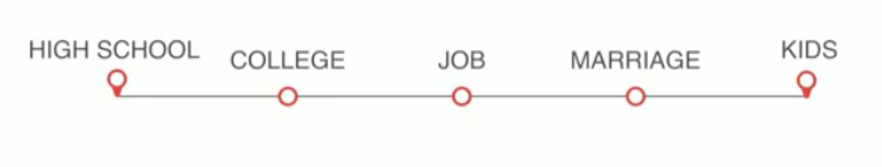
Becoming Adult WAS Linear

Slide 52
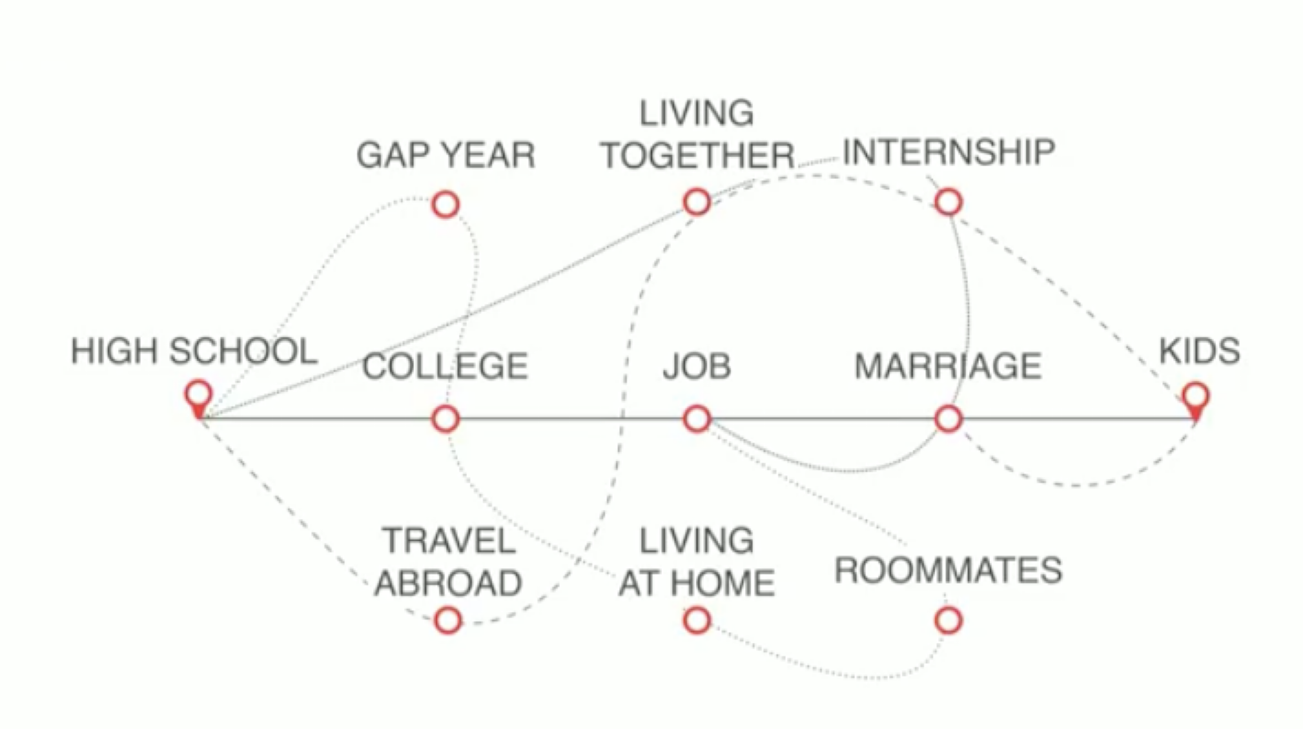
Becoming Adult is No Longer Linear

Slide 53
Not Just a Generational
Thing

Slide 54

Not Just a Generational Thing
2021

Slide 55
We are affected by:
Period Effects (terrorism)
    2. Life-Cycle Effects (puberty)
3. Cohort Effects (digital natives)

Slide 56
What to do with Millennials

Slide 57
What to do with Millennials
“For every complex problem there is a solution that is simple, neat,
and wrong.”
H. L. Mencken 2012

Slide 58
What to do with Millennials

Slide 59
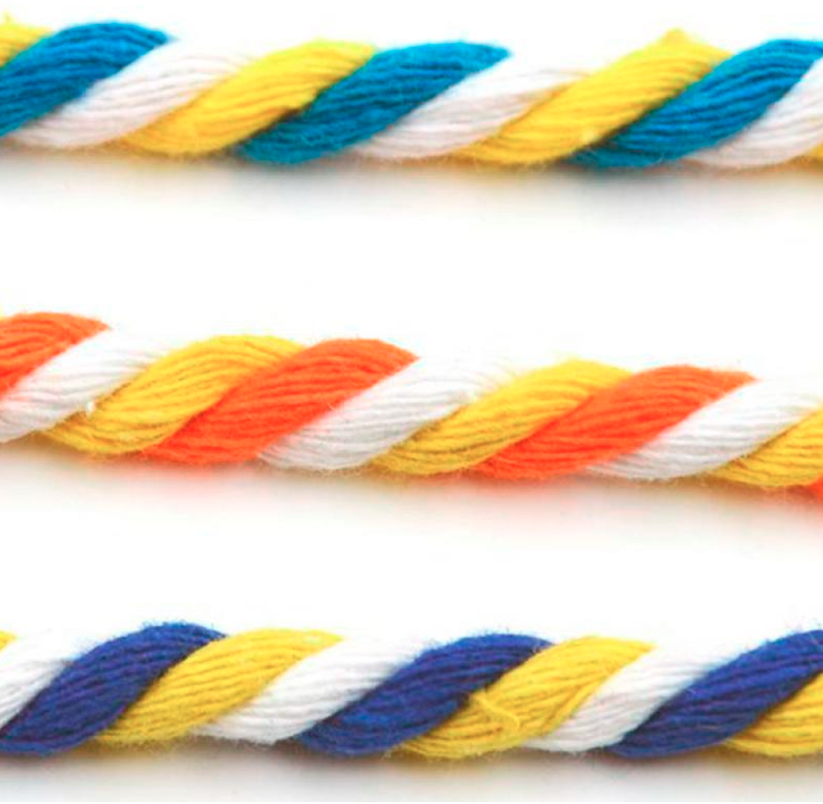
What to do with Millennials

Slide 60
What to do with Millennials
View the
“Millennial Generation” as one strand of a rope; not as the whole rope

Slide 61
What to do with Millennials
1. Generation
2. Stage of Development
3. Event & Culture change

Slide 62
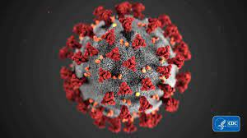
QUESTION

Slide 63
QUESTION
How was each generation affected by COVID-19?

Slide 64
TOMORROW AT 2:00 PM

Slide 65
TOMORROW AT 2:00 PM
Connecting with Millennials and Gen Z
PART 2

Slide 66
TOMORROW AT 2:00 PM
Connecting with Millennials and Gen Z
PART 2
What this has to do with the church, stewardship, and Adventism

Slide 67
Connecting with Millennials and Gen Z
PART 1
Steve Case
Stewardship Advisory
NAD Ministries Convention
January 8, 2023

