Slide 1

Conversations on Giving:
Demystifying Planned Giving
Copyright © 2022 by the General Conference of Seventh-day Adventists®. All rights reserved. The information is provided for training purposes only and is not intended nor should it be used as legal counsel. This program may not be used or reformulated for any commercial purposes; neither shall it be published by any person or agency other than an official organizational unit of the Seventh-day Adventist® Church, unless prior written authorization is obtained from the General Conference of Seventh-day Adventists® Office General Counsel. Subject to the foregoing terms, unlimited permission to copy or use this program is hereby granted upon inclusion of the copyright notice above. “Seventh-day Adventist” and “Adventist” are registered trademarks of the General Conference of Seventh-day Adventists® and may not be used by non-Seventh-day Adventist entities without prior written authorization from the General Conference. Use of all or any part of this program constitutes acceptance by the User of these terms.

Slide 2
Today’s Agenda
Organizational Development
Q&A
What is PGTS All About?
Donor Development
Types of Planned Gifts

Slide 3


What is PGTS All About?
Notes:
Fundraising gets a bad rap. Many people, when they hear the word fundraising, exclaim that we are not fundraisers.
I feel that fundraising is simply misunderstood. When approached from a Biblical perspective, fundraising is all about helping donors Experience the Joy of Giving, which is really how we were originally created.
Fundraising, especially Planned Giving, is not sales
To be successful in connecting donors to our charitable organizations we must avoid the outdated view of fundraising, which is that fundraising is a necessary evil meant to transfer the money from the donor’s pocket to our own charitable coffers.
When viewed properly fundraising is sacred work that channels, then unleashes the compassion of our donors and brings joy, commitment and partnership.
In fundraising, just as it is with stewardship, we must never be transactional, but transformative. And in no other aspect of fundraising is this more true than in planned giving.
By its very nature, planned giving is transformational. We help donors make transformational gifts. Gifts that not only have a huge impact on the organization receiving the gift. But Also on the Donor, because remember, it is MORE blessed to give, than to receive.
Sometimes it can be easy to get hung up on the complexity of the details of planned giving, and loose sight of what planned giving is truly all about.
I run the risk of missing the forest for the trees when I get so focused on tax benefits and legal structure of the gift that I forget these are all just a means to an end to accomplish something meaningful and lasting.
With all this in mind, when organizations engage in planned giving, to be successful, it must be all about developing a relationship with donors to understand their passions, their desires, and what they are trying to accomplish with their giving. When we have built this relationship with them, then we can help them make a truly transformational gift.

Slide 4

PGTS MISSION STATEMENT (NAD WP S40 01)
Planned Giving & Trust Services assists people in conveying their Christian values through planned gifts.
Our goal (as PGTS representatives) is to connect the donor’s passion with the mission of the Seventh-day Adventist Church so their gift will advance God’s work.
Notes:
PGTS representatives accomplish our goal by building a bridge between our organizations and our donors. This bridge, or relationship, must be nurtured, strengthened and grown over time so the donor and the organization can both benefit and accomplish a mutually desired outcome.
All three parties involved, the donor, the organization, and the PGTS representative must do their part to grow this relationship.

Slide 5

Organizational Development
Notes:
PGTS is an organizational endeavor. It can not be done solely by one or two people and be effective.
Every organization Must Create a Culture of Philanthropy in order to have a successful and thriving PGTS department.

Slide 6
RELIGIOUS GIVING: The Paradigm Shift in Religious Giving
The Old Paradigm
  – Based on Scarcity
Moral Obligation
Theology of Duty
Institution Centered
Institutions are to be Trusted
Budgets are Need-Driven
Fundraising is Raising Money
The Gift as an End to Philanthropy
The Emerging Paradigm
  – Based on Abundance
▪ Donor Cultivation
▪ Theology of Grace
▪ Donor Centered
▪ Institutional Trust must be Earned
▪ Giving is Value-Driven
▪ Fundraising is Nurturing Generosity
▪ The Gift as a Means to Philanthropy

Slide 7
Supply Side:
REVERSING THE PARADIGM: Fundraising as Supply vs. Demand
Demand Side:
The (old) Scolding Model
The (new) Inclination Model
Focus is on the individual and his/her passions
Potential donor is guided through a process of discernment
Goal: to inspire the donor’s imagination
Result: establishment of a relationship
Focus is on the case or need
Presentation is intended to awaken a sense of obligation or duty
Goal: guilt, via psychological or spiritual inducements, awakens donor
Result: contribution is secured

Slide 8

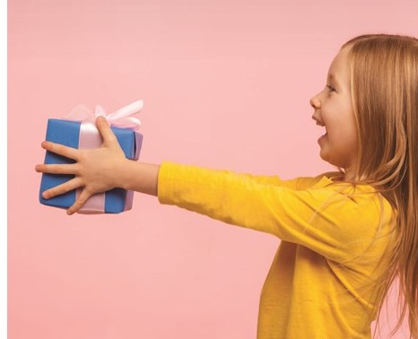
Donors give Planned Gifts to organizations they feel…
In the New Paradigm
Mission aligns with their passion
Will maintain its culture and identity
Will be a good steward of gifts they receive
Leadership is worthy of their faith
Notes:
We have to demonstrate that we are worthy of receiving their gifts.

Slide 9

Development Happens by
Creating a Culture of Giving
Within the Organization
Connect with Constituents
Make the Case for Support
Say Thank You
Report the Impact of Gifts
Notes:
These are activities that the organization must be constantly doing. Some things can and should be done by a department tasked with donor development, whether that is PGTS, Stewardship, or even better a department that melds the two into a department that is strategically working together.

Slide 10

Connect With Constituents
Volunteers
Provide Volunteering Opportunities
Committees
Service Work
Best way to connect!
Information
Keep informed
Emails & Newsletters
Magazines
Videos & Podcasts
Social Media
Events
Special Events
Seminars
Thank You Dinners
Reunions
Ask
Ask for gifts
Invite Donor Participation
Asking Matters!
Notes:
Keep the Donor Connected
Single best way to keep them connected is to have them volunteer
Keep them informed, emails, print magazines, newsletters, videos, podcasts, social media,
Seven touchpoints between solicitations
Asking for gifts Matters!

Slide 11

Make The Case For Support ― Help Donors Understand Why They Should Give Gifts to Your Organization
Have Clear Mission, and Plan for Accomplishing Your Mission
Demonstrate the Impact and Effectiveness of Your Organization
Show Worthiness of Receiving Gifts Through Good Stewardship and Transparency
Identify Gift Opportunities (Asking Matters!)
Clear Mission
Demonstrate Impact
Show Worthiness
Ask For the Gift

Slide 12

Say Thank You!
Send thank you email immediately (within 48 hours).
First time donors should receive special thank you email and/or phone call
Mail thank you letter and receipt within five business days of gift
End of year thank you and itemized charitable receipt
Notes:
Question – Should this pertain to returning a Tithe as well? Why or why not?

Slide 13
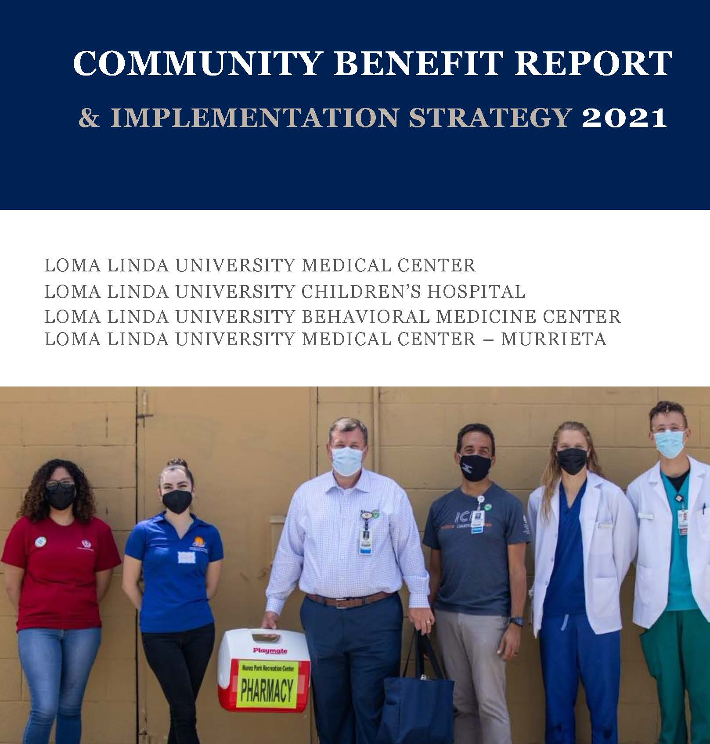
Report the Impact and Use of Gifts
Annual Donor Report
Tell Stories of Individual Lives Changed
Give Financial Accounting
Give Narrative of Major Achievements
Say “Thank You” to Donors

Slide 14
Institutional Development Exercise
How does your organization Inform Donors of its Mission and how it is accomplished? Is your communication effective?
On a scale of 1 – 10, How Trusted is Your Organization? How can your organization improve its trustworthiness?
In what ways does your organization Report the Impact and Use of gifts received?

Slide 15

Donor Development

Slide 16

Understand Where Many Donors Start
Many donors do not have a giving strategy in place.₁
Values play a huge part in determining the organizations they support.₁
Giving heavily influence by their culture.₂
Personal Satisfaction and Personal Connections rank as top two motivators.₃
1. 2021 Bank of America Study of Philanthropy: Charitable Giving by Affluent Households
2. 2016 DePaul University Cross-National Differences in Charitable Giving in the West and the World
3. 2022 BNY Mellon Charitable Giving Study: High Net Worth Investors’ experience with and attitudes toward charitable giving
Notes:
2021 Bank of America Study of Philanthropy: Charitable Giving by Affluent Households
- Households with a net worth of $1 million or more (excluding the value of their primary home) and/or an annual household income of $200,000 or more qualified to participate in this year’s survey.
2022 BNY Mellon Charitable Giving Study: High Net Worth Investors’ experience with and attitudes toward charitable giving
- have a minimum of $5 million in AUM
Giving Strategy –
More affluent people are, the more likely they are to having a giving strategy
BOA Study says 44.2% of Affluent households have a giving strategy
BNY Mellon study says 56% of those with at least $5 million in Assets Under Management have a giving strategy
Cultural Values influence their giving -

Slide 17

Don’t Assume
Uncover what the donor believes and feels
They may have completely different beliefs than you and may not even be Seventh-day Adventist
They may not want to give money to “Support the Lord’s Work”.
  But they may be interested in helping the homeless, or promoting good health, or financial responsibility, or some other initiative your organization engages in.
Notes:
************NEEDS WORK***********************
Must uncover what the donor believes and feels
You should not assume that they feel or believe in the same things you do.
They may not be Seventh-day Adventist.
They may not want to give money to “Support the Lord’s Work”.
But they may be interested in helping the homeless, or promoting good health, or financial responsibility, or some other initiative your organization engages in.

Slide 18

Connecting Values to Mission
What organizations are they currently giving to?
Why do they support these organizations?
What is it about your organization that they have supported it? And for so many years?
What do they hope to accomplish by giving to your organization?
Notes:
What organizations are they currently giving to? -- This gives us an idea of their total philanthropy, and gives us an idea of what they truly care about.
Why do they support these organizations? -- This also lets them know you care about them as a person, and not just how they can help further your mission.
What is it about your organization that they have supported it? And for so many years? -- Now this is drilling down to what value they see in partnering with your organization. This also opens up the possibility of sharing with them other ways they can achieve their philanthropic goals through your organization. They may be completely unaware of some programs they are not currently contributing to.
What do they hope to accomplish by giving to your organization? -- This again puts the spotlight on them.

Slide 19
Donor Development Exercise
What is one of your earliest memories of giving or receiving a gift?
Was there someone in your life who demonstrated giving of their money or their time?
What is the basis for your principles of giving?
When you think about asking a person for money, in person and out loud, how do you feel? What are the roots of these feelings?
How does knowing that a donor’s passion and your organization's mission are aligned impact your feelings on asking for a gift?
Notes:
Before we can know our donors we must know our selves.
Some may feel that Fundraising is the F Word and would never ever, not in a million years, ever want to ask people for money. I’m here to tell you it can be a joy! And it matters!
Give examples of why it can be a joy.
One way to get over the fear of asking for gifts is to wrestle with these ideas and understand our feelings on giving before we will be able to relate to what our donors are thinking.
Here are some questions you should think about

Slide 20
Conversation Step 1:
Build Trust & Explore Philanthropic Interests
Tell me your story with us? How did you first connect?
How did you decide to first start supporting us?
What means the most about what we do?
How have we impacted your (family, loved ones) life?
What has motivated you to be such a consistent supporter of ours?
What do you want to accomplish with your philanthropy?

Slide 21
Conversation Step 2: Introduce the Concept of a Planned Gift
Build On
Build on their story & their giving; Listen for a natural opportunity
Keep Simple
Keep it simple, resist the urge to give them all the details of how every planned gift works
Ask about
Ask about their past request for information, when relevant.
Stop & Listen
Stop and Listen; Let them respond, but keep the conversation going
Ask Permission
Ask permission to have a conversation about gift planning options
Notes:
Read through the bullet points and elaborate
*** Final Bullet Point *** Ask Permission – this is your segue into having that planned giving discussion. One way of doing that would be
“You’ve share that caring for children battling cancer especially weighs on your heart, and you have been contributing to this program for years. Would it be alright if we explored some ways you could make a transformative gift to benefit the children receiving treatment from our organization?”

Slide 22
Ask for the Gift Examples.
You remind me of another supporter who made a big difference by including us in his will. Is that something you would ever consider.
You’ve been such a devoted and generous supporter. Would you consider also including us in your future plans?
Can I help you explore ways to achieve your dreams for our organization?
In addition to leaving a legacy for your family, have you ever thought about leaving a philanthropic legacy?
Would you consider making us part of your philanthropic legacy?
Notes:
1st Example – Modeling
2nd Example – Appreciation
3rd Example – Asking Permission
4th Example – Acknowledging the donor’s greatest concern, family
5th Example – Straight forward

Slide 23
Conversation Step 3: Exploring Bequest Options & Assets
Explore best assets and type of Planned Gift
Keep the conversation moving forward
Build a clear picture of impact, outline action steps.
Facilitate closure.
Can I tell you how a bequest is a great way to establish a legacy?
Can I tell you about different ways to include us in estate plans?

Slide 24
Conversation Step 4: Closing Planned Giving Commitments
Restate
Restate what has been determined in the meeting(s)
Finalize
Finalize desired impact & confirm intent
Determine
Determine gift structure and provide needed documents or suggested language
Outline
Outline next steps
Obtain
Obtain Required Disclosure Forms or documentation and signature

Slide 25

Types of Planned Gifts

Slide 26
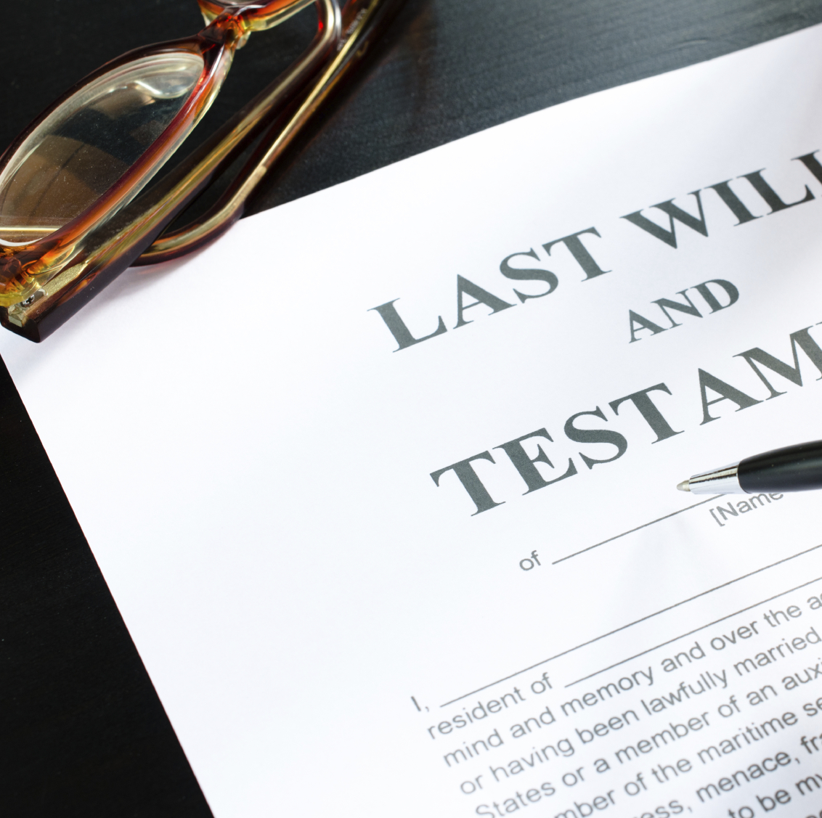
Bequests and Beneficiary Designations
Bequests in a will or trust
Designations in retirement accounts, bank accounts, and life insurance
Most common form of estate gifts
Can be a specific amount, e.g. $10,000 to charity
Can be a percentage of the remainder interest, e.g. 10% of the remainder to the charity
Can be a specific asset, or part of the asset, such as IRA or Real Estate

Slide 27

Meet Ann
Lived in her house for fifty years
No debt on the property
Widow with only one son
Only income is Social Security and a pension
Good health and does not want to move
Concerned about son having to sell the house
Long time donor
Wishes to create an endowment to support your programs in perpetuity
Notes:
Ann has lived in her house in Memphis for fifty years, and the mortgage has been paid off for decades. She is widowed and her only son lives in California. Her only income is Social Security and a pension earned by her late husband. She remains in good health and does not want to move from her home. But she is concerned about the burden on her son of having to deal with selling the house from California when she passes away. Ann has been a donor to your organization for many years and wishes to someday create an endowment to help support your programs in perpetuity.

Slide 28
Planned Gift Options
Bequest in a will of all or part of her house to the charity
Create a Transfer on Death Deed to give all or part of the property to the charity (Not available in all states)
Establish a trust with a trustee to sell the property and direct the proceeds to the charity and her son
Create a Life Estate
Create an endowment now to be funded by the planned gift later

Slide 29

Meet Harry and Beth
Harry and Beth are both age sixty-five and close to retirement
Have a substantial portfolio of growth stocks
Concerned about their granddaughter
They want to provide something for her
They would like to make a current major gift to your organization
Notes:
Harry and Beth are both age sixty-five and close to retirement. They have a substantial portfolio of growth stocks built up over the years. Most of the stocks pay little dividend. They want to maintain enough in their estate to provide something to her after they are both deceased. They would like to make a major gift to your capital campaign but have been unable to reach a decision.

Slide 30
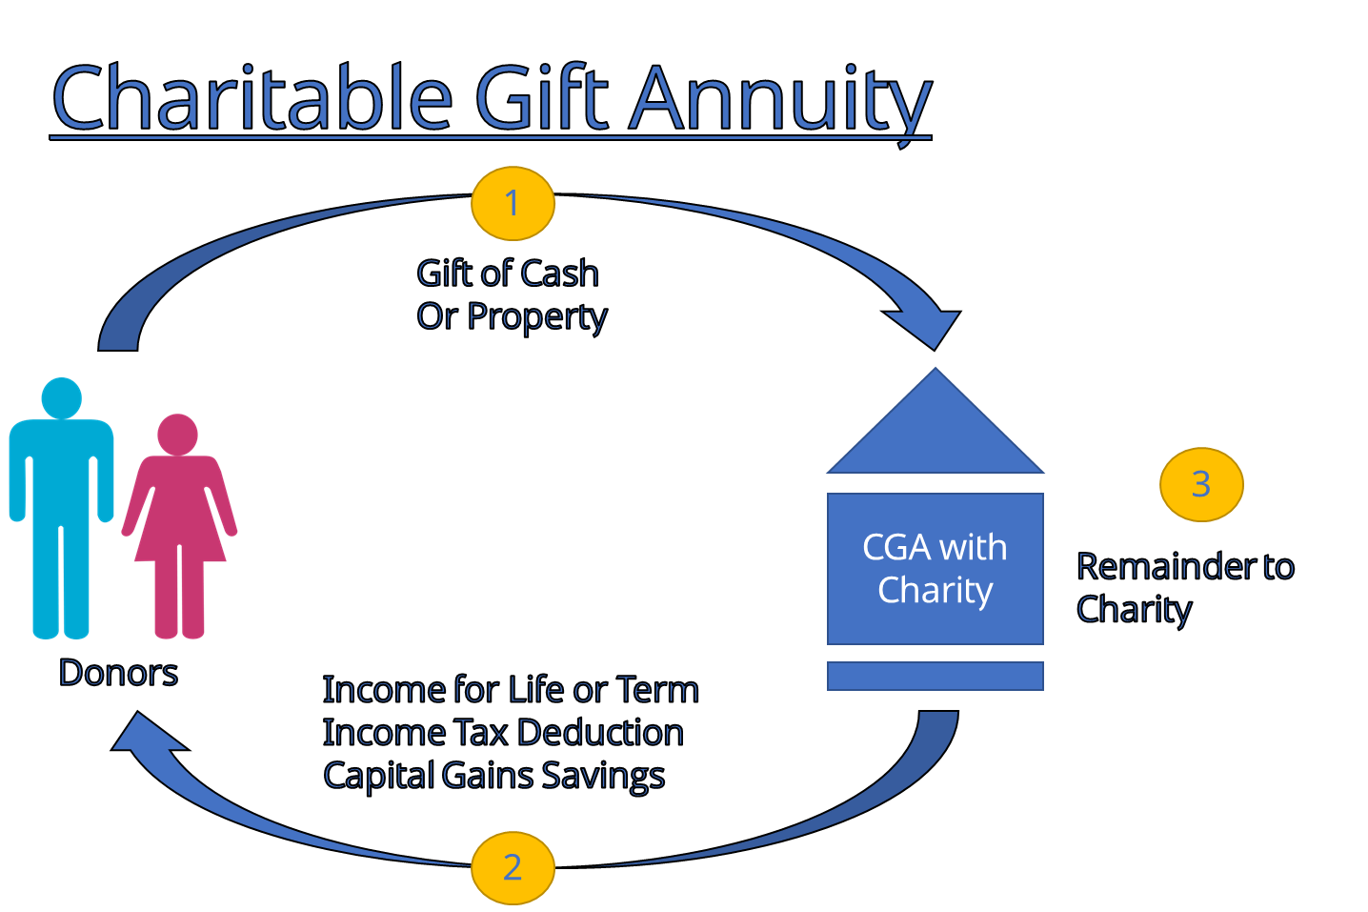
Charitable Gift Annuity

Slide 31
Planned Gift Options
Blended Gift
Outright Gift of Stock to the Campaign
Use some stock to fund a CGA for Granddaughter
OR –
Use the CGA Income to Purchase Life Insurance for Granddaughter
Establish a Special Needs Trust for the Life Insurance Death Benefit
Notes:
Another option is a CLT
Charitable Lead Trust
Use stock to fund a CLT
Payments made to the organization for number of years
Asset reverts to granddaughter to fund a special needs trust

Slide 32

Meet Mark & Tina
Long Time Donors to Organization
Mark is Retiring In a Year From 7 Figure Income
They Own 12 Rental Properties
Want to Simplify Their Lives in Retirement
Want to Continue Managing Some Rental Properties
Want to Support Several Charitable Organizations

Slide 33

Planned Gift Options
Create a CRUT
Place All 12 Rental Units in the Trust
Sell ¼ of the Rentals, Trustor Can Continue Managing Other Rentals
Setup Charity as Primary Charitable Beneficiary
Donor Retains Right to Change the Charitable Beneficiaries to Add Additional Organizations at Later Date

Slide 34
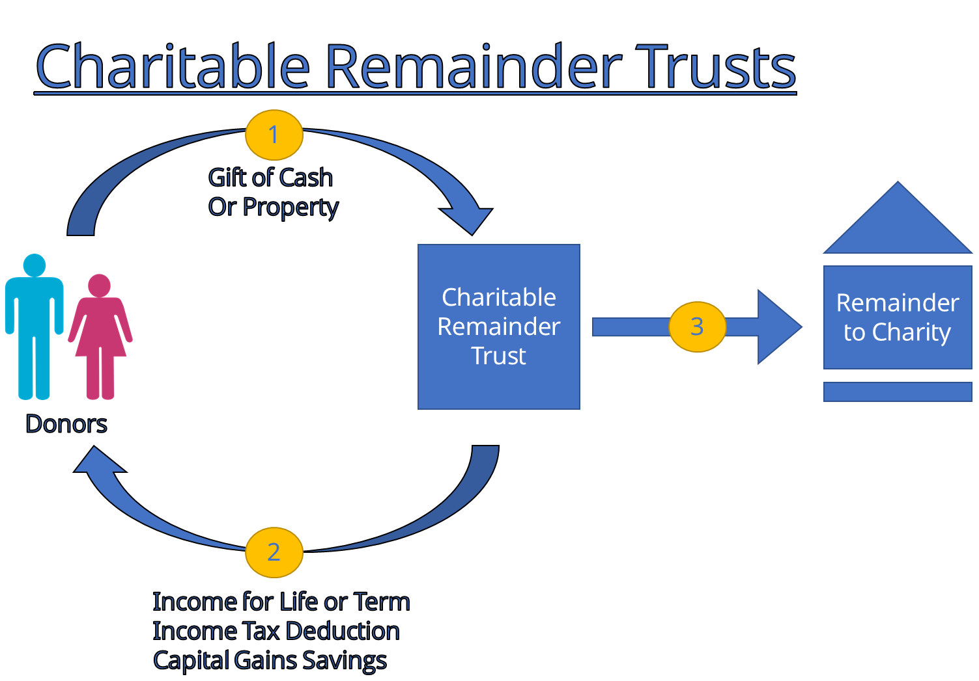
Charitable Remainder Trust

Slide 35


