Slide 1

A Stewardship Plan for the Local Church
TRACY B. JOHN

Slide 2
Objectives
To provide spiritual training to board members. If anyone has not accepted Jesus as Lord of their lives, help him or her to make that decision.
To educate the entire church body.
To provide money management education to the entire church body and to the community.

Slide 3
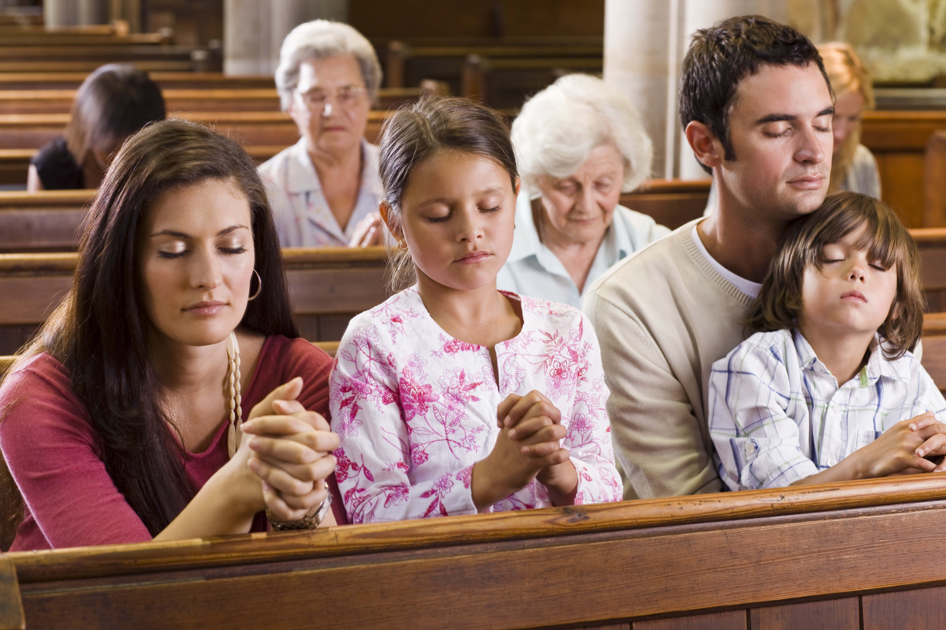
Desired Outcome
The desire outcome is for members to grow in relationship with Jesus and become passionate about glorifying Him in all areas of their lives.

Slide 4

Organize a Stewardship Committee
  Select five to seven members who can model faithful stewardship. Avoid using members of the Finance Committee.
  Committee to assist the departments to plan programs emphasizing stewardship in their various programs.

Slide 5
Church Board Education & Training (First Quarter)
  Offer presentations to board members with emphasis on commitment, faithfulness, and relationship.
  Educate members on Church structure.
  Provide each officer with a copy of the Stewardship Quick Start Guide.

Slide 6
Church Board Education & Training (First Quarter)
  Guide departmental leaders in outlining objectives and plans for a one- to two-year plan.
  Encourage church to follow a Giving Calendar.
  Adopt ministries outside of the local church.

Slide 7
Finance Committee (Ongoing)
  Finance committee should practice diligent care in fund disbursement ensuring that all funds disbursed are in accordance to the department’s objective.
  Inform board and church of all financial activities on a regular basis.
  With the exception of Pathfinders and Adventurers, discourage the various departmental dues.

Slide 8
Prayer Ministries: Relationship and Faith (Ongoing)
  We build a relationship with God through prayer and study. Wednesday Night Prayer Meeting is the perfect opportunity to strengthen our relationship, yet there is little or no emphasis on improving or attracting members and visitors to these meetings. Also, a vibrant prayer ministry can contribute to reducing stewardship problems.

Slide 9
Prayer Ministries: Relationship and Faith (Ongoing)
  Suggestions for a complete makeover of Prayer Meetings:
  Make prayer meeting more attractive/appealing, such as encouraging members to share stories of how it has made a difference in their lives.
  Invest time in planning for the meetings.
  Train elders to conduct Prayer Meeting.

Slide 10
Prayer Ministries: Relationship and Faith (Ongoing)
  Advertise (not announce) Prayer Meeting on a weekly basis.
  Place flyers on the bulletin board and posters outside the building.
  Conduct Prayer Meeting like we do the eleven o’clock Sabbath service.

Slide 11
Education to the Entire
Church Body (Ongoing)
  Create a schedule for sharing regular Stewardship messages from the pulpit.
  Teach broad view of Stewardship, not just emphasize money.
  Encourage elders to use offertory readings as a means of education on commitment, faithfulness, relationship etc. (Go to www.nadstewardship.org to access electronic version.)

Slide 12
Education to the Entire
Church Body (Ongoing)
  Read offering appeals with emphasis and passion!
  Offer annual Money Management seminars for various groups, such as AYS, Family Life, Children’s Ministry, etc.
  Place Stewardship quotations in the church bulletin.

Slide 13
Education to the Entire
Church Body (Ongoing)
  Share at least one Stewardship story per quarter for the Children’s Story.
  Ask members to testify of God’s faithfulness during a 10-minutes Stewardship Emphasis (3rd Sabbath) and the Praise Report Session of the mid-day service.

Slide 14
ANNUAL SCHEDULE

Slide 15
Year 1: Quarters 1 and 2
Train and educate officers.
Educate the church body on the broad view of Stewardship.

Slide 16
Year 1: Quarter 3
1. Implement the Giving Calendar.
2. Launch strategically-planned Prayer Meetings.
3. Emphasize our relationship with God.
4. Encourage personal devotions.

Slide 17
Year 1: Quarter 4
Emphasize Service (talents).
Perform gift assessment test (especially for the youth).

Slide 18
Year 2: Quarter 1
Create opportunities for young people to serve in the areas in which they are gifted. Even if they have not been officially elected, they can assist.
Emphasize our Temple (stewardship of mind and body, health and purity).

Slide 19
Year 2: Quarter 2
1. Emphasize Giving.
2. Conduct seminars for various groups: married/singles, children, Pathfinders, etc.

Slide 20
POST YEAR 2

Slide 21
Post Year 2
After Year 2, a capital project may be launched, if needed.
To begin a capital project, contact the North American Division Philanthropic Service for Institutions office.

Slide 22
Post Year 2
Adopt a theme or name for the project. Example of a theme: “We are doing are great work, so we cannot come down.” (Nehemiah)
Make use of Biblical examples. Various lessons can be taught from the book of Nehemiah and others.
Plan Prayer and Fasting sessions.
Offer six weeks of spiritual training to Board members.
Offer Forty Days of Prayer and Fasting for the entire church body. Daily devotionals will be provided.

Slide 23
Post Year 2
Adopt Biblical models of giving.
Appeal for money, internally and externally.
Thank contributing members and businesses in the community on a regular basis for their contributions.
Perform yearly evaluations on number of participants and demonstrated interest.
One of the greatest methods to increase member giving is to have vibrant ministries that are mission-driven. People will give to mission, not maintenance.

