Slide 1

A Heart for Christ
TRACY B. JOHN

Slide 2
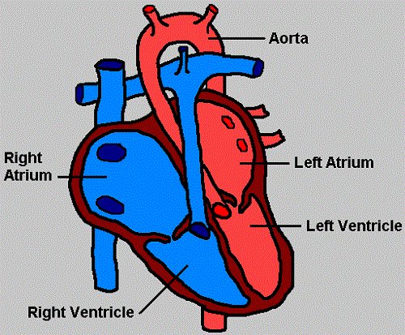
One of the Most Important Organs:
The Heart

Slide 3
Dr. Neal Barnard
“By the time many people reach their 20s, blockages that disrupt the flow of blood already exist within their arteries. When particles of cholesterol, fat, and other cells build up in the arteries they eventually form plaques that obstruct blood flow. These blockages affect the arteries leading to the heart, causing chest pain and often result in heart attack.”
(http://www.pcrm.org/nbBlog/index.php/the-warning-signs-of-clogged-arteries)

Slide 4
An Important Organ
“Guard your heart above all else, for everything we do flows out of it,” (Proverbs 4:23, NIV).

Slide 5
Maintain A Healthy Heart (Physical)
Eat right
Be active
Maintain an appropriate body weight
Quit smoking
Control cholesterol
Avoid alcohol
Manage stress

Slide 6
Maintain A Healthy Heart (Spiritual)
Eat right — God’s Word
Be active – Use talents
Maintain your weight – Strip off sins
Quit smoking – Quit bad habits/company
Control cholesterol – Walk in and Live the Word
Avoid alcohol – Avoid all evil
Manage stress – Don’t worry

Slide 7
What is Stewardship?
Stewardship is a heart condition.

Slide 8
What is Stewardship?
In Hebrew thought, heart and mind are often used interchangeably.

Slide 9
Matthew 22:36-38
“’Teacher, which is the greatest commandment in the Law?’ Jesus replied: ‘Love the Lord your God with all your heart and with all your soul and with all your mind. This is the first and greatest commandment.’”

Slide 10
Symptoms of Spiritual Heart Disease
Ungratefulness (never satisfied).
Constant worry about money.
Busyness.
Constant excuses for not giving.
5. Finds reasons for not using talents.

Slide 11
Symptoms of a Healthy Heart
(Christ is Center)
Expresses an attitude of gratitude
Experiences contentment.
Seeks opportunities to give.
Uses talents for God’s glory.
Spends time with God.
Share’s God’s goodness.
Devotes time to serve.
Values family.

Slide 12
Christ In The Heart
“When the perfect love of God is in the heart, wonderful things will be done. Christ will be in the heart of the believer as a well of water springing up into everlasting life. When the heart is cleansed from sin, Christ is placed on the throne that self-indulgence and love of earthly treasure once occupied.

Slide 13
Christ In The Heart
“The image of Christ is seen in the expression of the countenance. The work of sanctification is carried forward in the soul. Self-righteousness is banished. There is seen the putting on of the new man, which after Christ is created in righteousness and true holiness,” (Counsels on Stewardship, 27).

Slide 14
PURPOSE
You will be purpose-driven. You will know you are special and you are called.
“But you are not like that, for you are a chosen people. You are royal priests, a holy nation, God’s very own possession. As a result, you can show others the goodness of God, for he called you out of the darkness into his wonderful light.,” (1 Peter 2:9, NLT).

Slide 15
PASSION
When Jesus is center of your life, His will becomes your desire. You’ll remain focused, despite challenges and temptations.
“Take delight in the Lord, and he will give you your heart’s desires,” (Psalm 37:4, NLT).

Slide 16
PURITY
When Christ is center you will keep your mind and body pure.
“Run from anything that stimulates youthful lusts. Instead, pursue righteous living, faithfulness, love, and peace. Enjoy the companionship of those who call on the Lord with pure hearts, (2 Timothy 2:22, NLT).

Slide 17
Where Is Your Heart?
“For where your treasure is, there your heart will be also,” (Matthew 6:21, NIV).

Slide 18
Paul’s Prayer for Spiritual Growth
“When I think of all this, I fall to my knees and pray to the Father, the Creator of everything in heaven and on earth. I pray that from his glorious, unlimited resources he will empower you with inner strength through his Spirit. Then Christ will make his home in your hearts as you trust in him. Your roots will grow down into God’s love and keep you strong. And may you have the power to understand, as all God’s people should, how wide, how long, how high, and how deep his love is.

Slide 19
Paul’s Prayer for Spiritual Growth
May you experience the love of Christ, though it is too great to understand fully. Then you will be made complete with all the fullness of life and power that comes from God. Now all glory to God, who is able, through his mighty power at work within us, to accomplish infinitely more than we might ask or think. Glory to him in the church and in Christ Jesus through all generations forever and ever! Amen,” (Ephesians 3:14-21, NLT).

Slide 20
Jesus is Knocking
“Look! I stand at the door and knock. If you hear my voice and open the door, I will come in, and we will share a meal together as friends,” (Revelation 3:20, NLT).

Slide 21
The Savior Is Waiting
The Savior is waiting to enter your heart
Why don’t you let Him come in?
There’s nothing in this world to keep you apart
What is your answer to Him?

