Slide 1

Whose Is It, Anyway?
Tracy B. John

Slide 2
What is Stewardship?
Stewardship is “the careful and responsible management of something entrusted to one’s care.”
https://www.merriam-webster.com/dictionary/stewardship

Slide 3
Christian Stewardship
The careful and responsible management of all that God has given us—our tangible and intangible possessions.

Slide 4
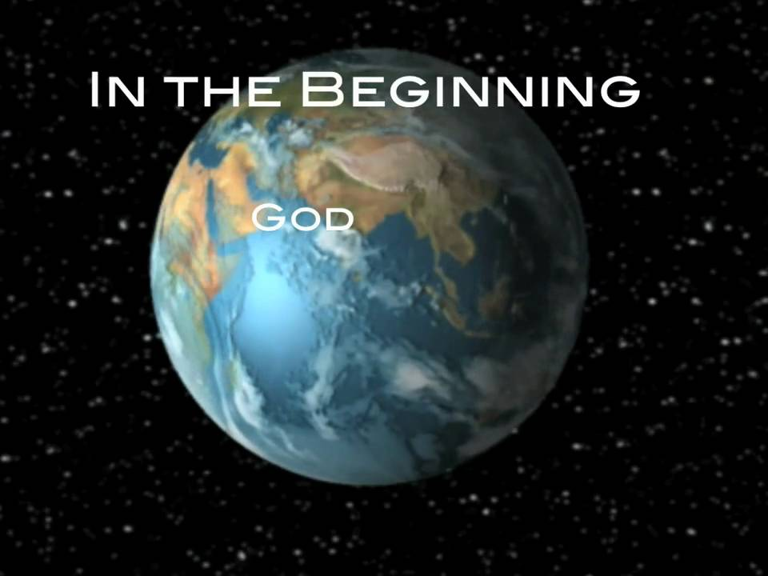
Creator
  “In the beginning God created the heavens and the earth,” (Genesis 1:1, NKJV).

Slide 5
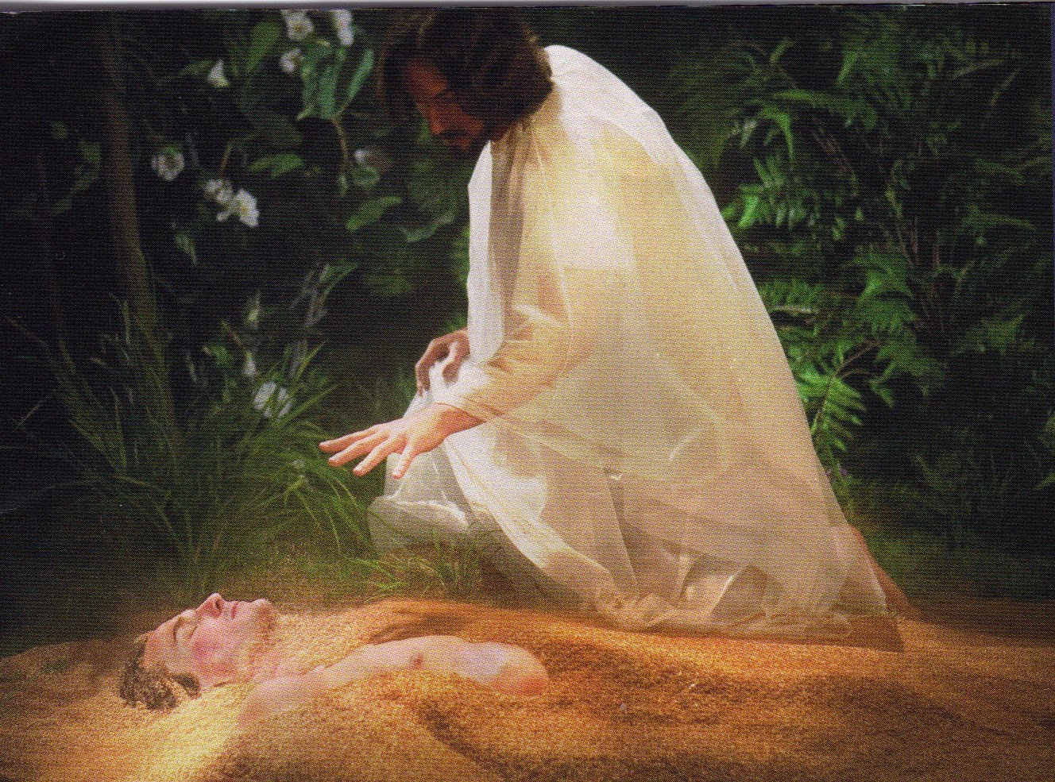
God Created Man

Slide 6
Owner
  “The earth is the Lord’s, and all its fullness, the world and those who dwell therein,” (Psalm 24:1, NKJV).

Slide 7

Mankind’s Responsibility
“Then God said, ‘Let us make human beings in our image, to be like us. They will reign over the fish in the sea, the birds in the sky, the livestock, all the wild animals on the earth, and the small animals that scurry along the ground’” (Genesis 1:26, NLT).

Slide 8
Mankind’s Responsibility
Mankind’s ability to possess does not grant entitlement or ownership.

Slide 9
Advancements
This generation has surpassed all other in the following:
Technology
Transportation
Infrastructure
Medicine
Standard of living

Slide 10
“To have is to owe, not to own,” (Unknown).

Slide 11

Employer/Employee
Computer belongs
to the employer.
Information belongs
to the employer.
Printer belongs
to the employer.
Paper belongs
to the employer.
The report belongs
to the employer.

Slide 12
Man Owns Nothing
“For we brought nothing into this world, and it is certain we can carry nothing out,” (1 Timothy 6:7, NKJV).

Slide 13
God Gives Resources
With the exception of time, God gives resources to every person in different proportions:
Time
Talent
Treasure
Temple

Slide 14
God is Not Needy
Returning gifts to God is an act of obedience.

Slide 15
We Give Thee But Thine Own
(verse 1)
“We give Thee but Thine own,
Whate’er the gift may be;
All that we have is Thine alone,
A trust, O Lord, from Thee.”

Slide 16
We Give Thee But Thine Own
(verse 2)
“May we Thy bounties thus
As stewards true receive
And gladly, as Thou blessest us,
To Thee our first-fruits give!”
(SDA Hymnal, 670)

Slide 17
A Steward’s Job Description
Follow safe and proper procedures.
Perform duties as instructed.
Arrive on time and demonstrate effective time management.
Improve skills and abilities through continued learning.
Work well with others.

Slide 18
A Steward’s Attitude
Gratitude
Contentment
Loyalty
Generosity
Charity
Compassion
Obedience

Slide 19
God Gives…..
“But remember the LORD your God, for it is he who gives you the ability to produce wealth, and so confirms his covenant, which he swore to your ancestors, as it is today,” (Deuteronomy 8:18, NIV).

Slide 20
Is It Mine?
My energies
My labor
My mental capacity
My car
My house
My phone
My children
My body

Slide 21
Quiz – True/False
When God gives us gifts or property, we become owners.
We manage our gifts based on how we feel.
God is Creator; therefore, He is Owner.
Man has the ability to produce using God’s resources.
God owns natural resources, man owns technology.

Slide 22
Quiz – True/False
God gives equal resources to all men.
Health, strength, abilities, and wealth are given to us by God to be used for His glory.
All those who return tithe are faithful stewards.
God is Owner of our houses, cars, children, and cell phones.
10. After Creation week, God ceased from creating.
Notes:
ANSWER KEY:
False
False
True
True
False
False
True
False
True
False

Slide 23
Stewardship Resources
Copyright © 2018, North American Division of Seventh-day Adventists,
Notes:
ANSWER KEY:
False
False
True
True
False
False
True
False
True
False

